Slide 1
International president's Report
Salla Tuominen
2024-2026

Slide 2
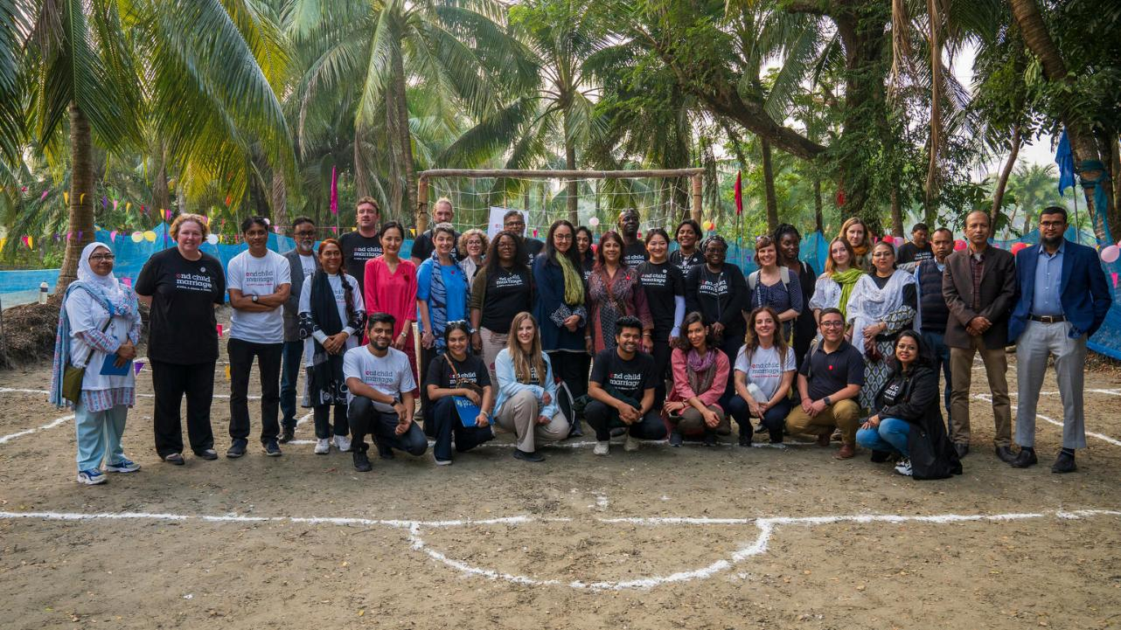
WELCOME!

Slide 3
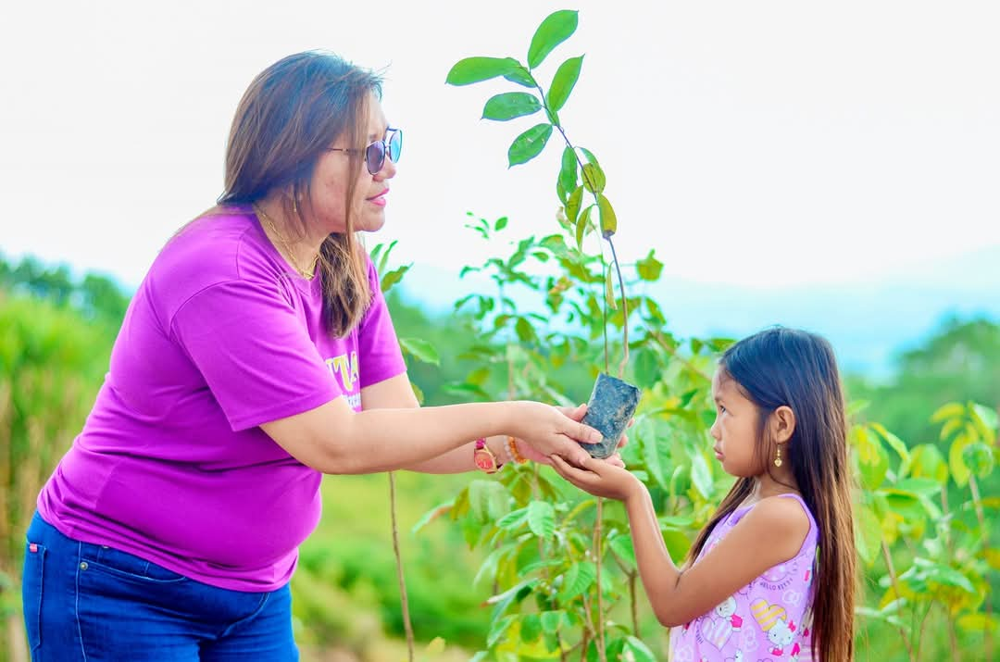
Global
Challenges
Nueva Vizcaya
Rollback of
Women’s Rights
Governments decreasing funds
for foreign aid
Global
Conflict
Climate
Crises
Zonta Spirit, Sustainability and Speaking up for Human Rights

Slide 4

Biennial Goals
1
2
3
4
Credible and
Visible Voice
Club
Successes
Leadership and Sustainability
Engagement
of Audiences and Allies
Zonta Spirit, Sustainability and Speaking up for Human Rights

Slide 5
Goal 1
Credible
and Visible Voice
Zonta acts as a credible and visible voice on gender equity, driving change for gender equality.
Zonta Spirit, Sustainability and Speaking up for Human Rights

Slide 6
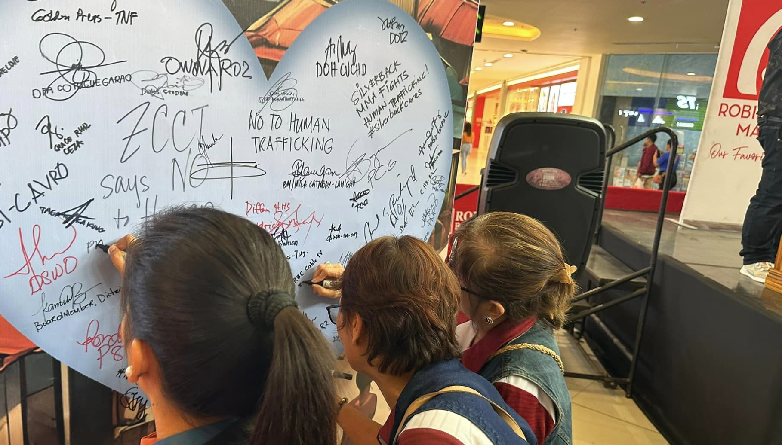
KEY FOCUS AREAS
        Violence Against Women
        Climate Justice
        Women in Decision-Making Positions
        Education Equity
Central Tuguegarao

Slide 7
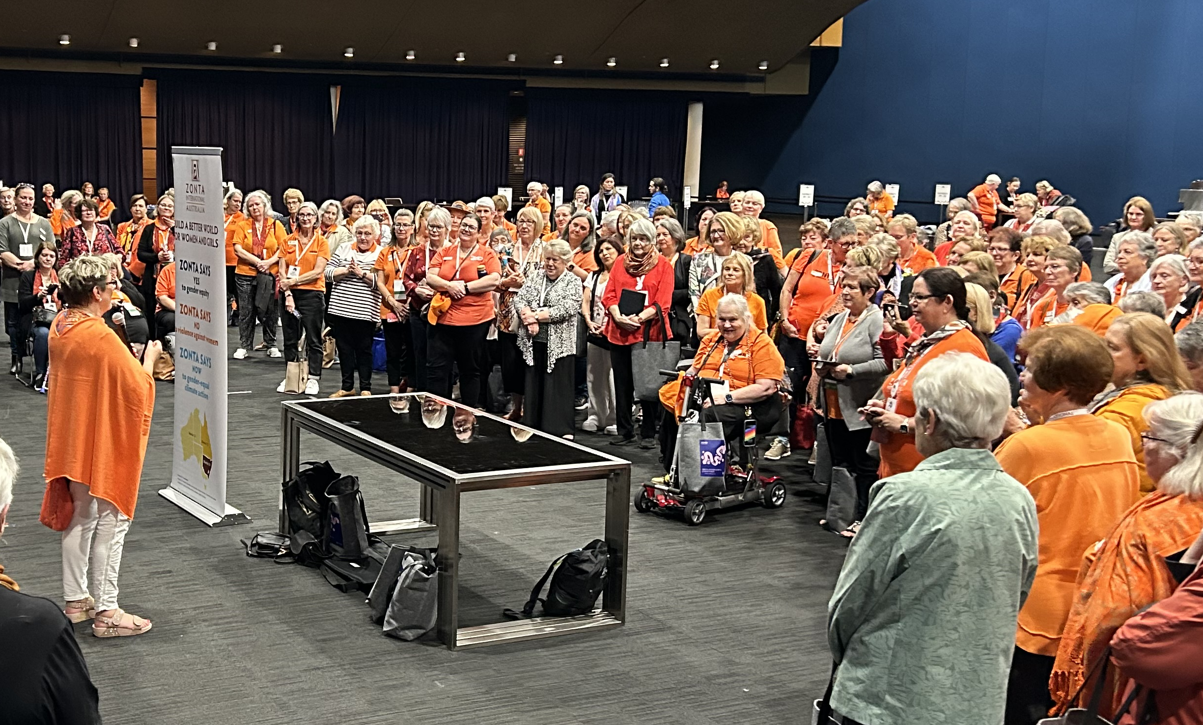
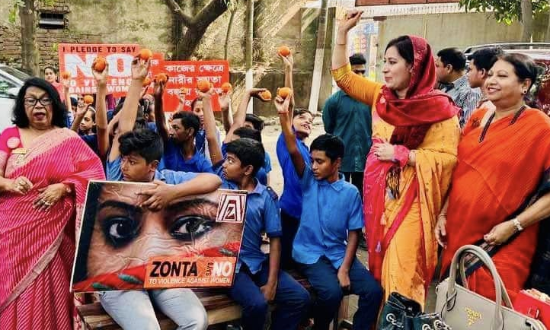

WHAT WE HAVE ACHIEVED
      First new country-level advocacy
      group established in Australia
      Zonta Says NO to Violence Against Women
      Quarterly virtual advocacy series
Hua-Lien
Zonta Spirit, Sustainability and Speaking up for Human Rights

Slide 8
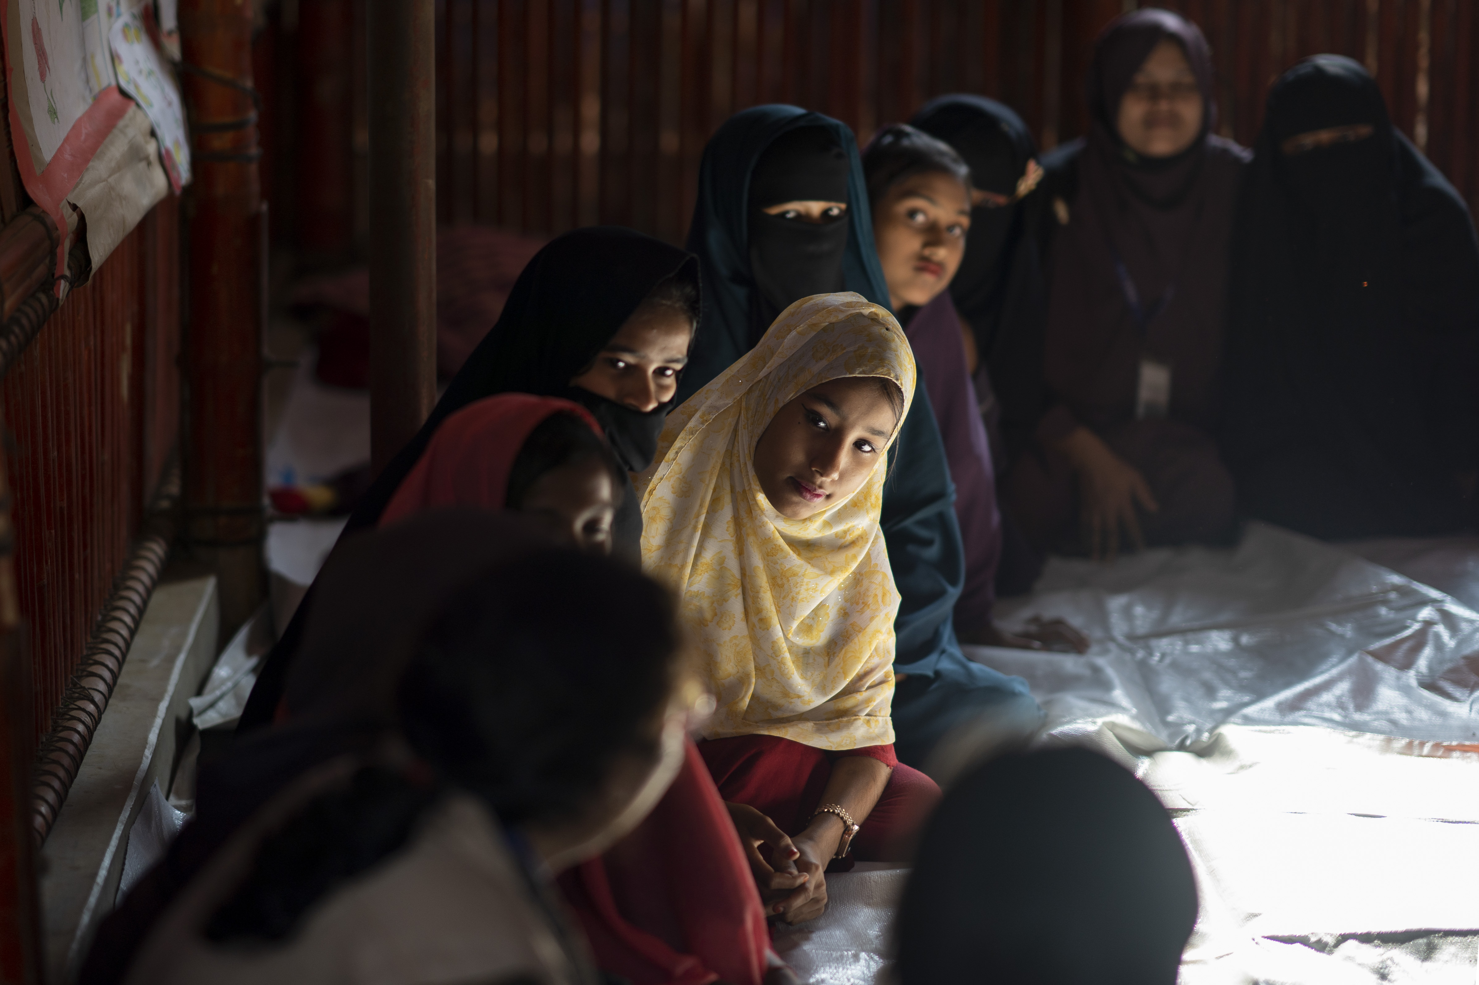
Site Visit to Bangladesh
      640 million girls and women alive today were married in childhood.
      45% of child brides live in South Asia (290 million)
      15% live in East Asia and the Pacific (95 million)
www.unicefusa.org

Slide 9
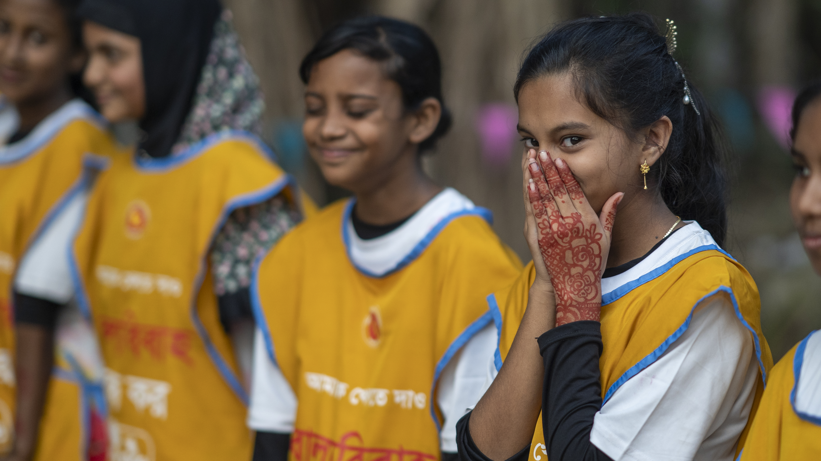
Site Visit to Bangladesh
      Child marriage in South Asia dropped from 46% to 26% in last 10 years.
      78% of averted child marriages in the past 25 years were in South Asia.
      Largest declines in India, with notable declines in Bangladesh.
www.unicefusa.org

Slide 10


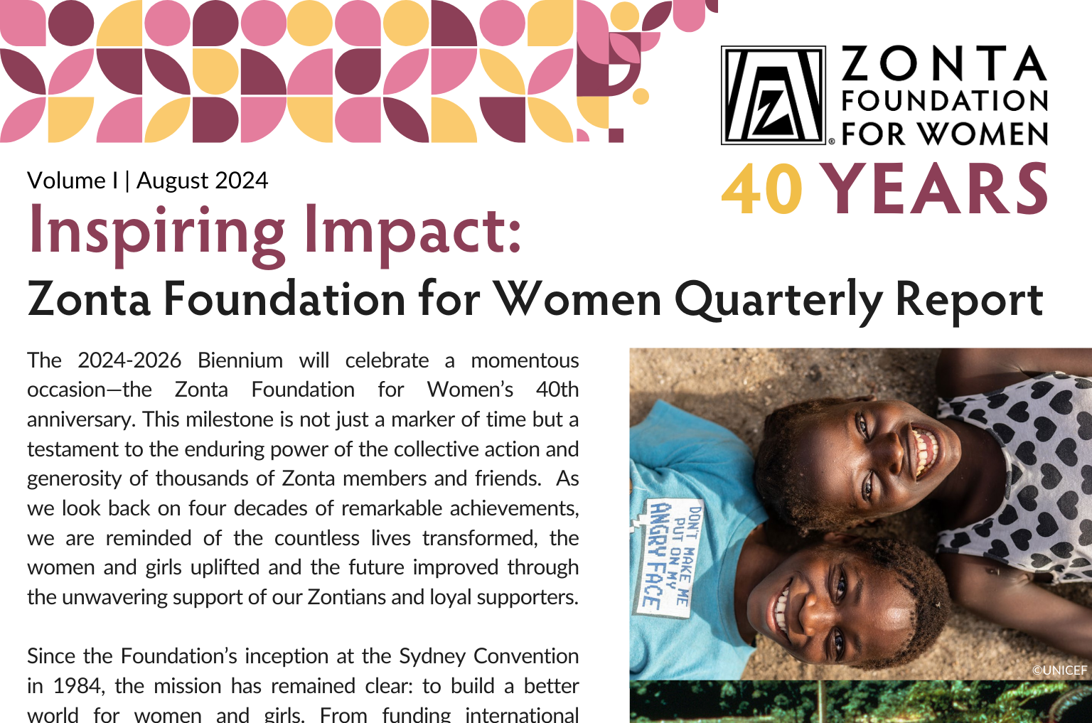
WHAT WE HAVE ACHIEVED
      Officially launched Zonta Women in Business Leadership and Zonta Women in STEM Award
      Remarkable Women Powerful Stories
      Quarterly stakeholder newsletter for
      Zonta Foundation for Women
Zonta Spirit, Sustainability and Speaking up for Human Rights

Slide 11
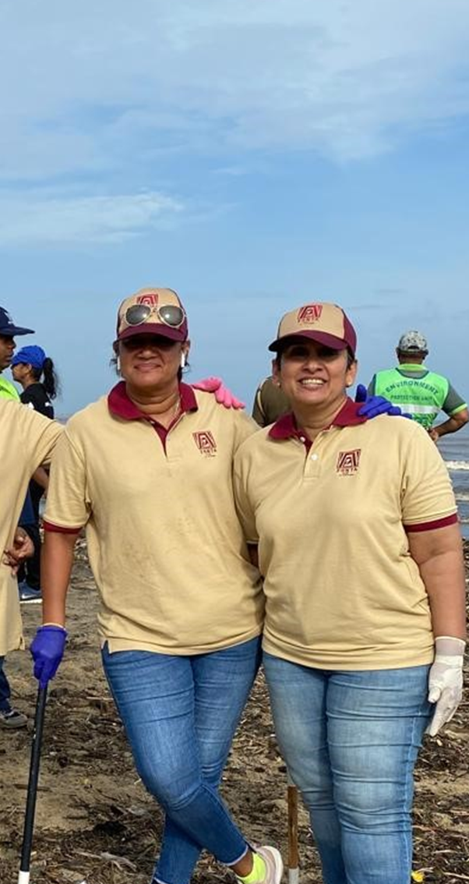
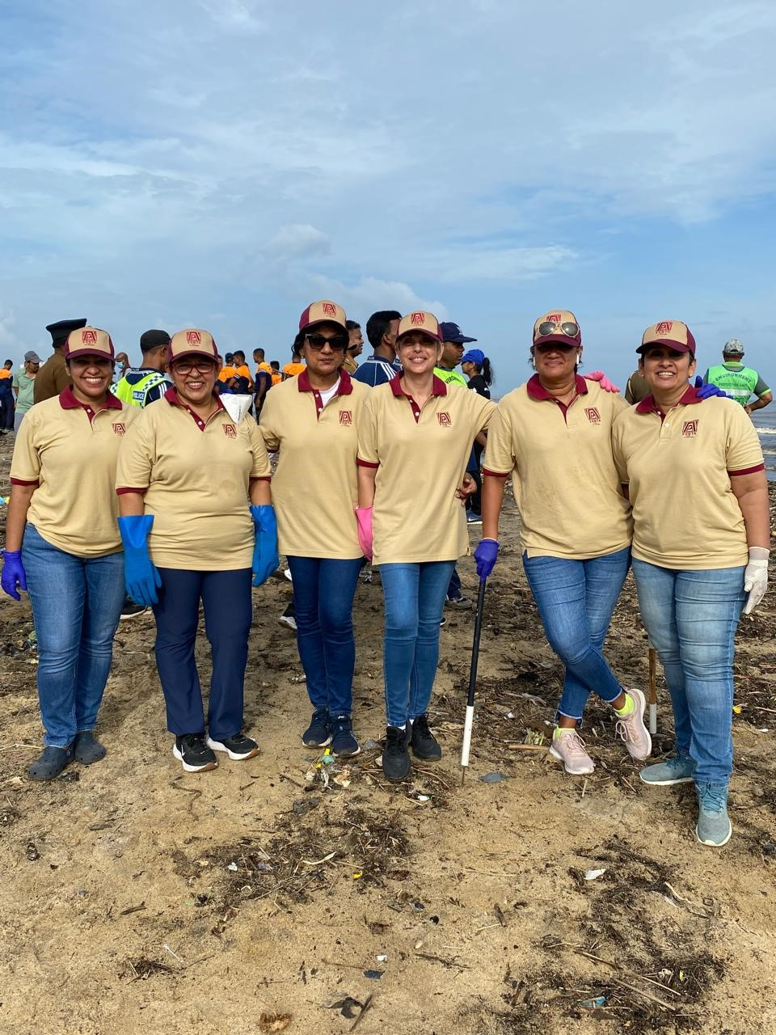
WHAT WE HAVE LEFT TO DO
  Internal advocacy training program coming soon
  Elevating Equality
  on Earth Day
  22 APRIL
Colombo

Slide 12
Goal 2
Club Successes
By focusing on club success, Zonta maintains a strong membership base to support the work we do to build a better world for women and girls.
Zonta Spirit, Sustainability and Speaking up for Human Rights

Slide 13
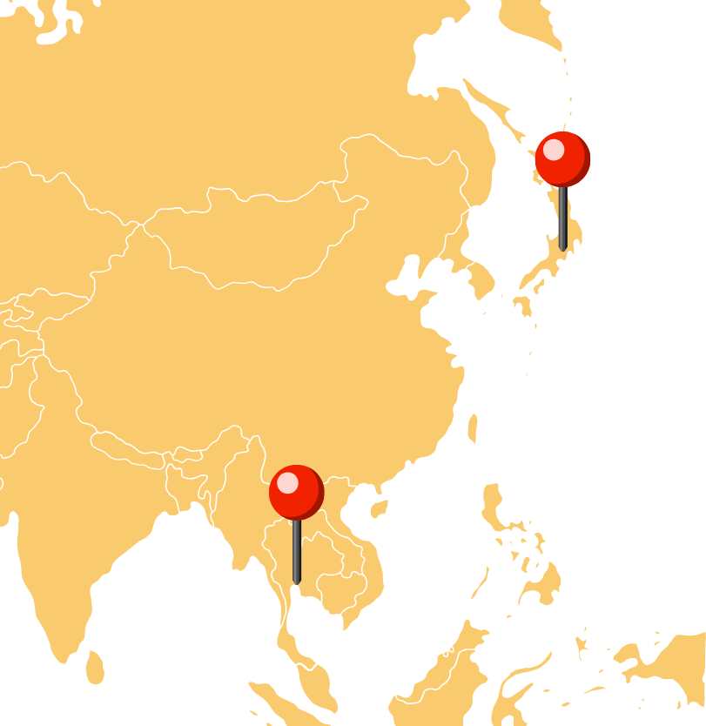

WHAT WE HAVE ACHIEVED
Chartering of new clubs this biennium
  Zonta Club of Thonburi, Thailand, District 17
  Zonta e-Club of Yokohama Sakura, Japan, District 26
  10 clubs now forming
Twinning program launched
Zonta Spirit, Sustainability and Speaking up for Human Rights

Slide 14
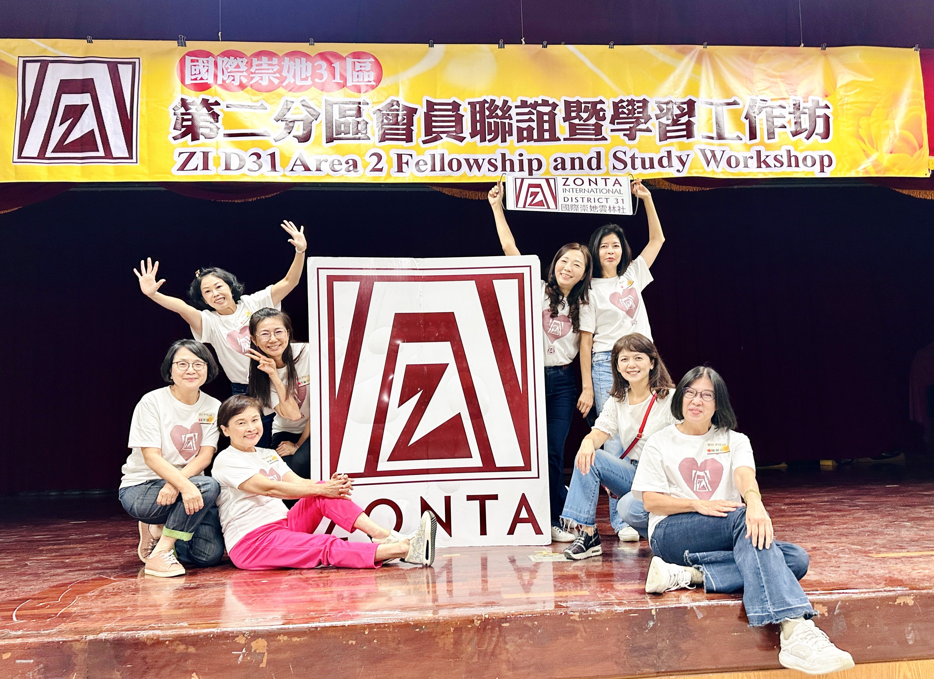
WHAT WE HAVE LEFT TO DO
  Finalize core values of code of conduct
  Finalize membership strategy
  Complete Community Give Back Grants feasibility study
  Share Your Story Festival
  Assess clubs and ensure they are fit for the future
District 31, Area 2

Slide 15
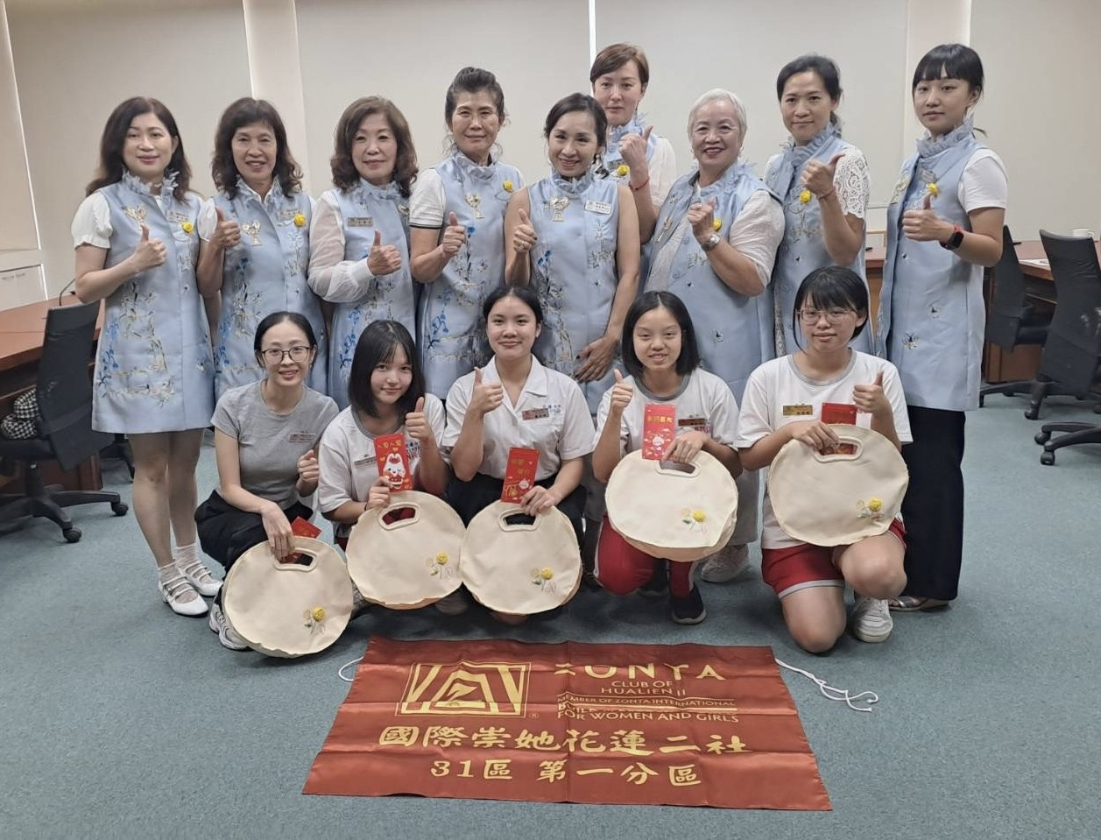
WHAT WE HAVE LEFT TO DO
  Engage youth members – involve your student clubs.
  Diversify membership by asking others to “Add Your Voice!”
Hualien II

Slide 16
Goal 3
Leadership and Sustainability
Zonta manages its resources, including both time and money, to meet Zonta’s vision and ensure Zonta’s long-term viability and success.
Zonta Spirit, Sustainability and Speaking up for Human Rights

Slide 17
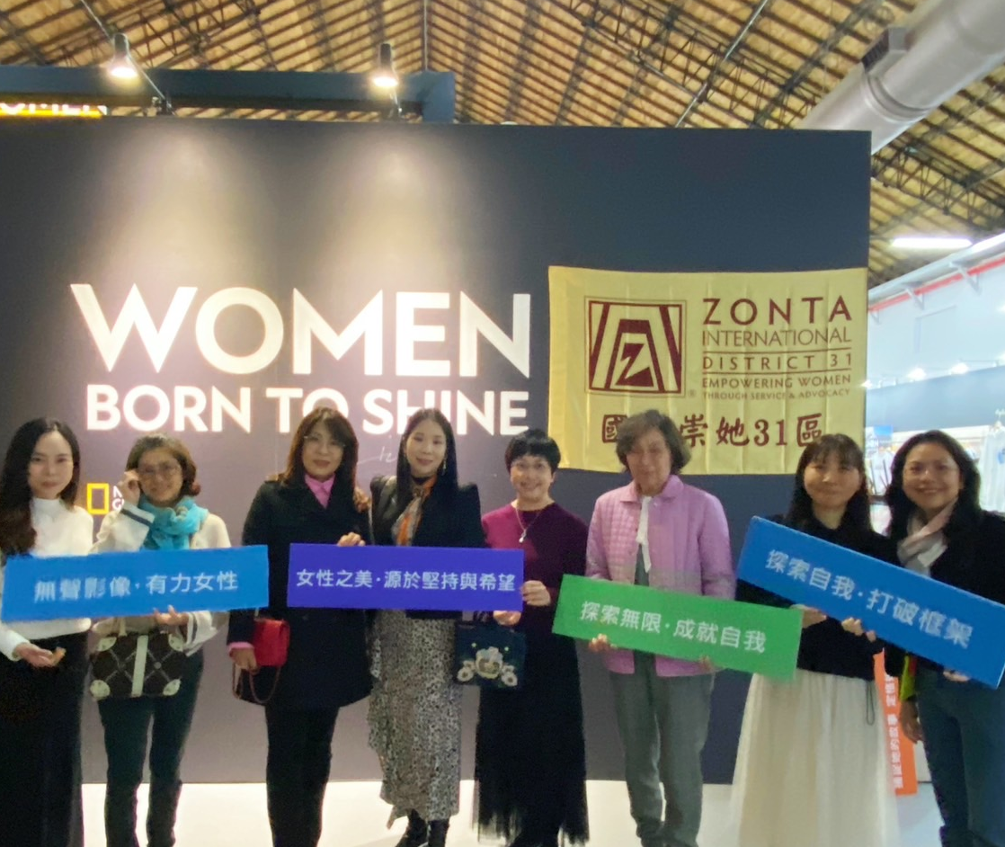
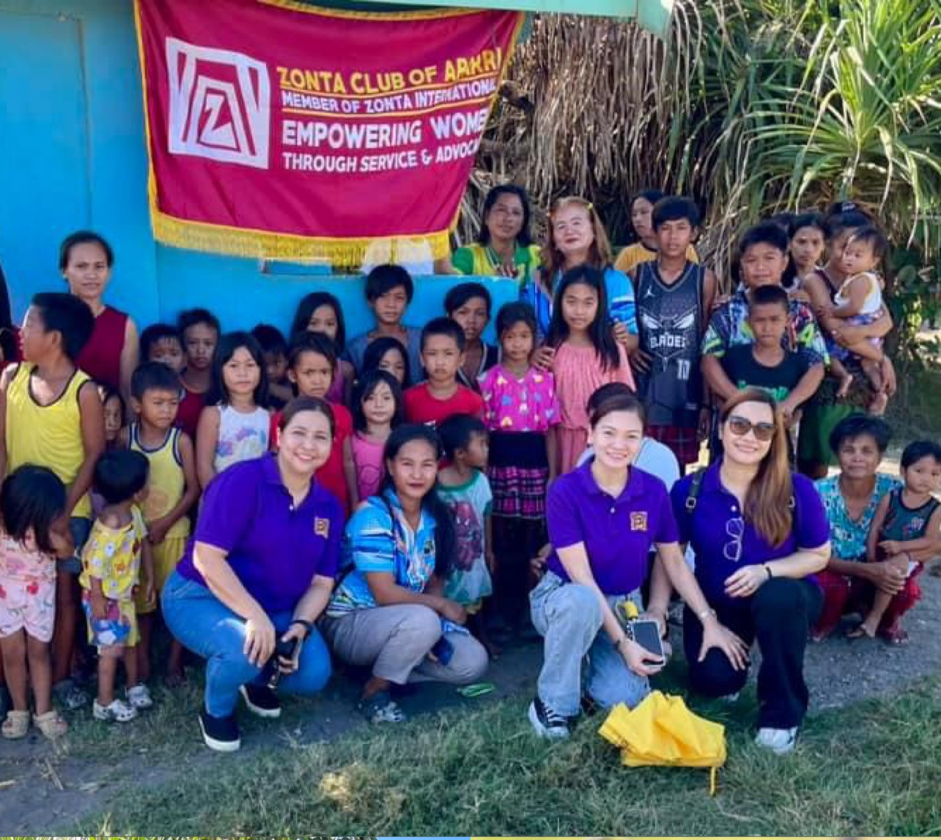
WHAT WE HAVE ACHIEVED
Implementation and monitoring
of the strategic plan
10-Year Forecast updated
  Alternative revenue working group for ZI
  Diversifying support for the Foundation
Taipei I
Taipei I
Appari
Zonta Spirit, Sustainability and Speaking up for Human Rights

Slide 18
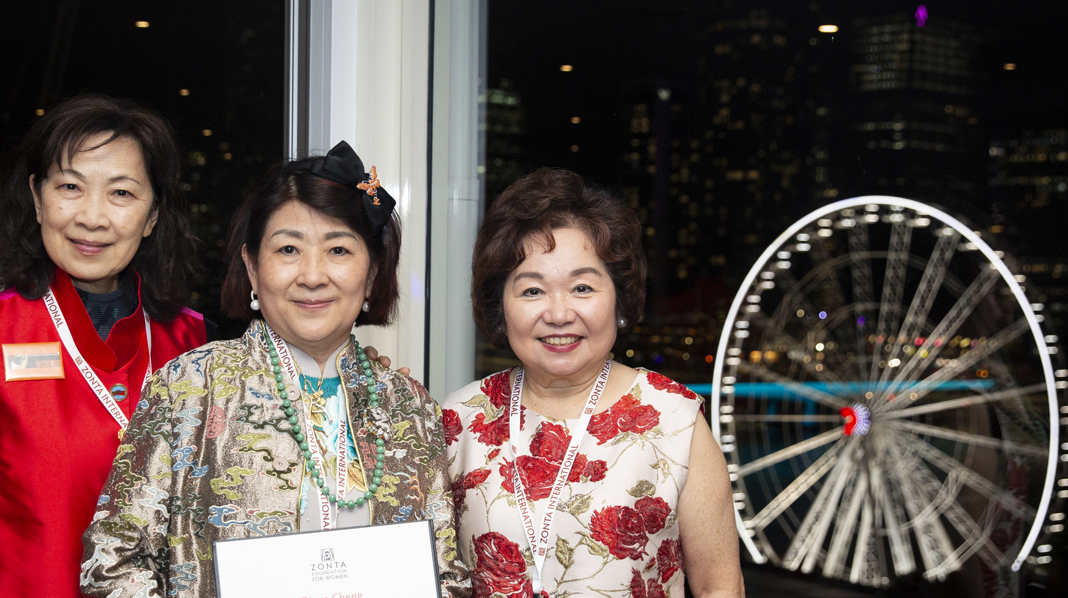
WHAT WE HAVE LEFT TO DO
  40th anniversary campaign
  Zonta 1919 Legacy Giving Circle
  Governance review
  Complete ESG review

Slide 19
Goal 4
Engagement of Audiences and Allies
In order to further Zonta’s mission and extend voice, Zonta develops collaborations with like-minded organizations.
Zonta Spirit, Sustainability and Speaking up for Human Rights

Slide 20
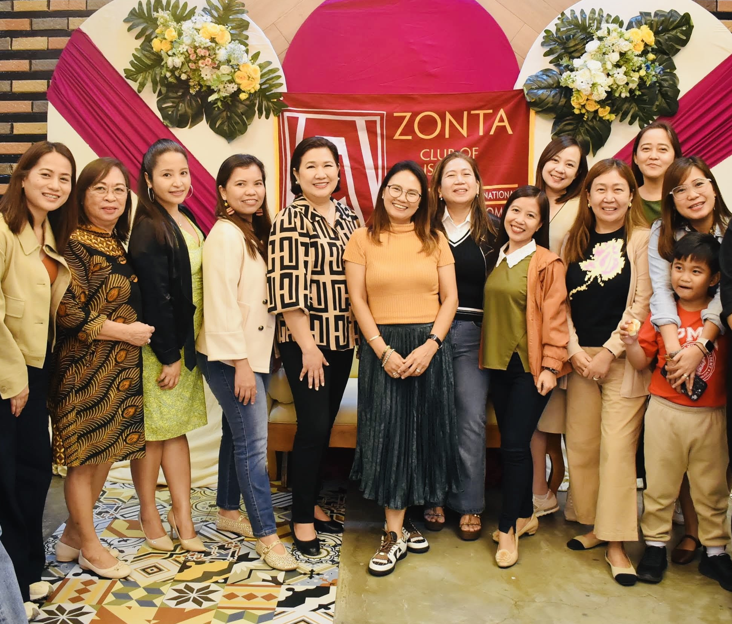
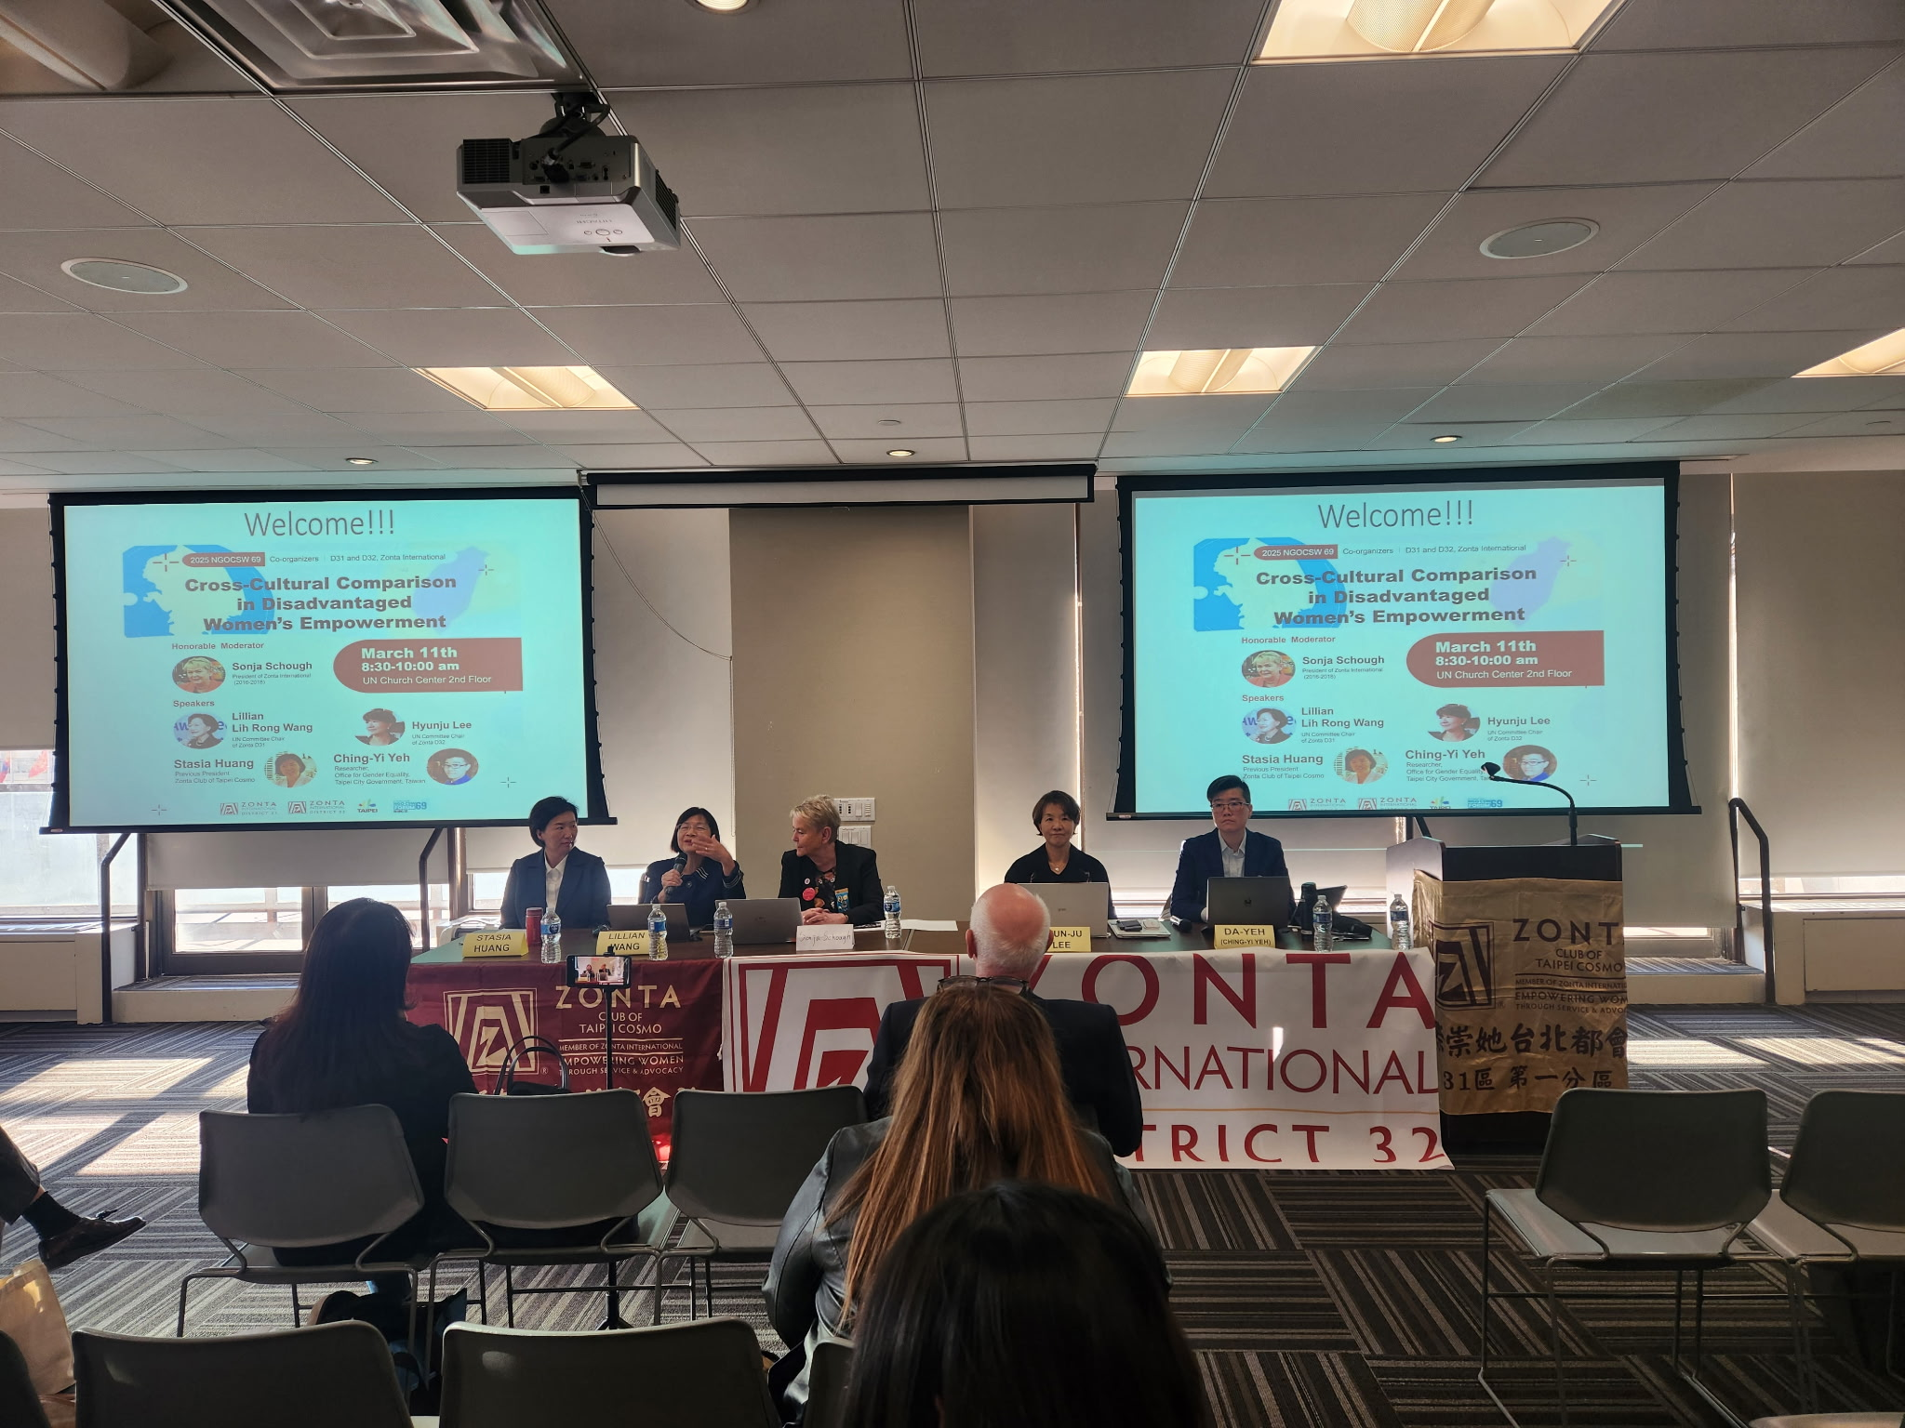
WHAT WE HAVE ACHIEVED
Greater focus on work at the Council of Europe
69th Session of the Commission on the Status of Women was a success!
Great to see event led by
District 31 & District 32!
Dhaka I
Zonta Spirit, Sustainability and Speaking up for Human Rights

Slide 21
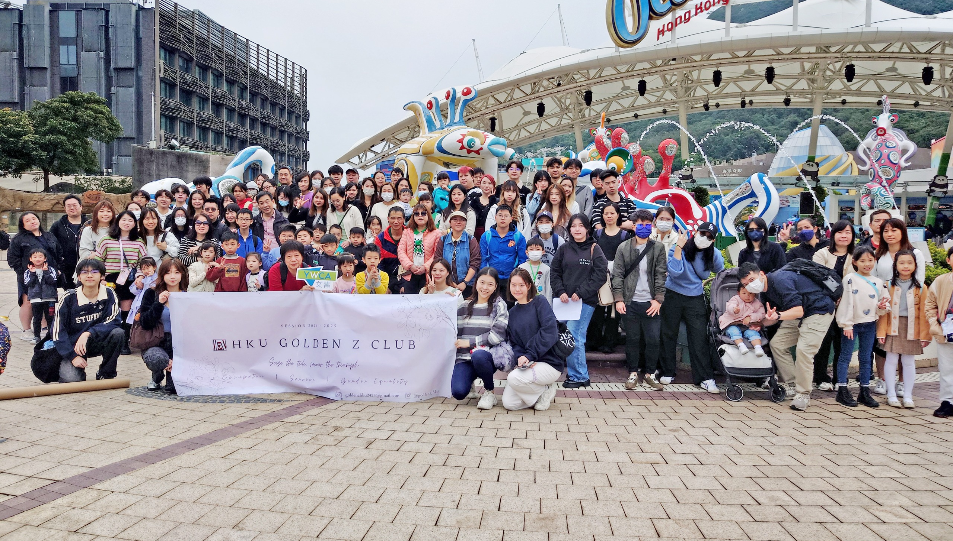
WHAT WE HAVE LEFT TO DO
  Increase knowledge of Zonta’s work at the United Nations
  Secure corporate sponsorships
Hong Kong

Slide 22
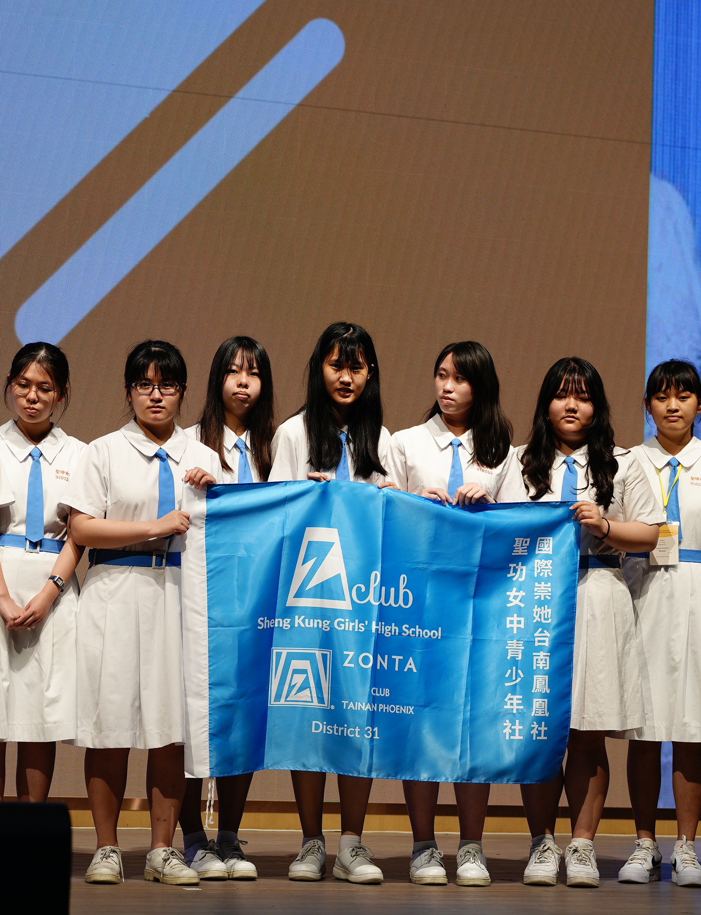
WHY DOES ZONTA HAVE INTERDISTRICT MEETINGS?
Allows Zontians to gather across districts in years without an international convention.
Creates a cross-district and cross-cultural exchange of ideas.
Opportunities for networking.
Engaging ways to learn more about Zonta’s key focus areas.
Zonta Spirit, Sustainability and Speaking up for Human Rights

Slide 23
UPCOMING OPPORTUNITIES FOR INVOLVEMENT IN 2025
22 APR
ELEVATE EQUALITY ON EARTH DAY
APR
MAY
ADD YOUR VOICE CAMPAIGN
MEMBERSHIP RENEWAL
AUG
SHARE YOUR STORY FESTIVAL

Slide 24
UPCOMING OPPORTUNITIES FOR INVOLVEMENT IN 2025
SEPT
OCT
DISTRICT CONFERENCES
11 OCT
INTERNATIONAL DAY OF THE GIRL
25 NOV
10 DEC
16 DAYS OF ACTIVISM
ZONTA SAYS NO CAMPAIGN

Slide 25

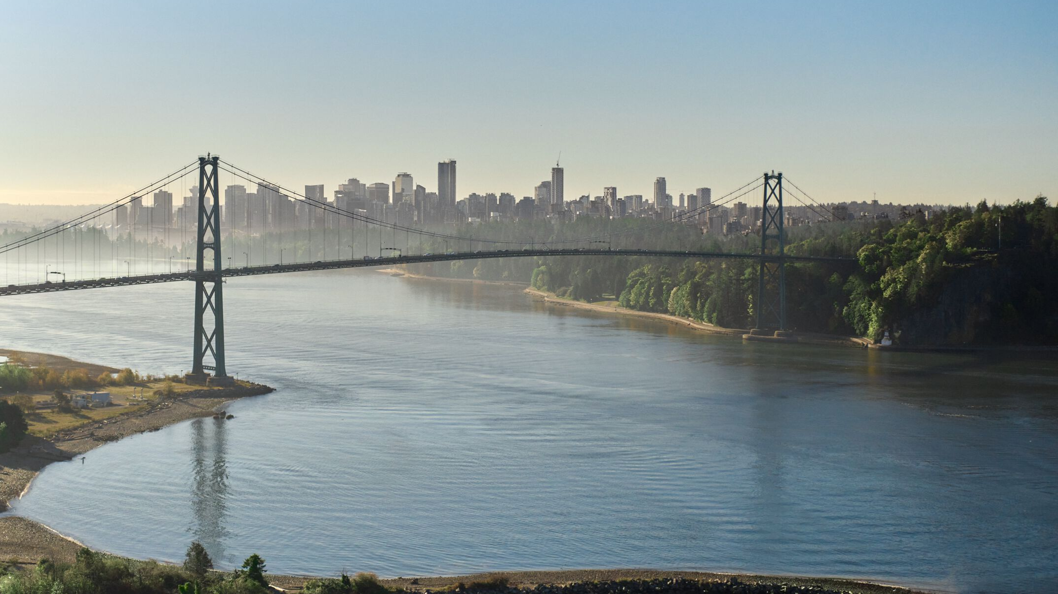
11-14 JULY 2026

