Slide 1
Activities of UN Women
Hiroko HASHIMOTO
President,Japan National Committee for UN Women
Notes:
It is my great pleasure to introduce activities of UN Women as well as its challenges in promoting gender equality

Slide 2
Establishment of UN Women
UN Women was established in 2010 to promote gender equality and empowerment of women and girls by integrating and developing the following four women-related organizations of United Nations:
(1)United Nations Office for Women (Secretariat for the United Nations Commission on the Status of Women (CSW), established in 1946 by the strong proposal from Mrs Eleanor Roosevelt and other ladies. At that time there was Human Rights Committee, but no committee for women.
UNIFEM (United Nations Development Fund for Women)
International Research and Training Institute for Women
(４)Office of the Special Adviser to the Secretary-General of the United Nations established after the Beijing Conference

Slide 3
Japan National Committee for UN Women
Japan's only NGO that financially supports and publicizes the activities of UN Women.
Similar organizations have been established in following 12 countries;
Austraria, Austria, Finland, France, Germany, Iceland, Italy, Netherland, New Zealand, Spain, Sweden, United Kingdom
Japan National Committee for UN Women collects contributions from civil society as well as companies to support UN Women

Slide 4
The 69th CSW, 10-21 March, 2025
The first day of the 69th CSW agreed Political declaration on the occasion of the 30th anniversary of the Fourth World Conference on Women.
Regional preparation toward 69th CSW
Asia and the Pacific
UN ESCAP organized the Asia-Pacific Ministerial Conference on the Beijing+30 Review, in collaboration with UN Women Regional Office for Asia and the Pacific from 19 to 21 November 2024.

Slide 5
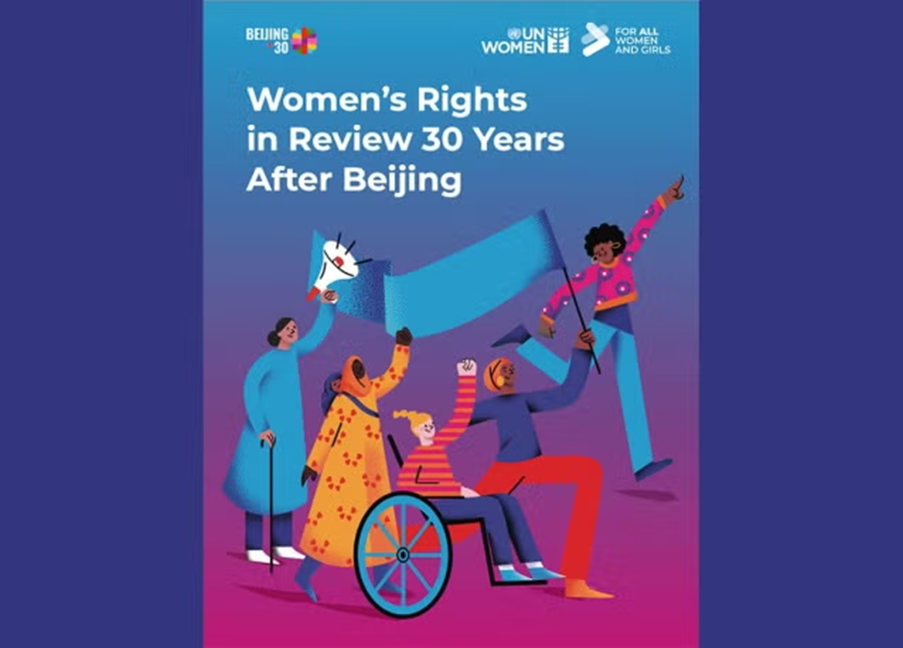
Beijing +30 review(UN Women organized 10-21th March 2025, NY)
One in four countries reported backlash on women’s rights in 2024

Slide 7
Zontians at CSW69 in New York proudly displayed on the Zonta Tote bag“Negotiate your salary, not your rights”
This is a part of the message which Ms Mariko Asano, Zonta International District 26 received from Ms Salla Tuominen,President 2024-2026 Zonta International and Zonta Foundation following to the closing of the 69th CSW on March 21 2025.

Slide 8
Ⅱ. UN Women’s Activities in 10 Areas 1/2
1. Governance and Political Participation in the Public Sphere
2. Women's Economic Empowerment
3. the Elimination of Violence Against Women including operation of the United Nations Trust Fund to End Violence Against Women
4. Women's Involvement in Disaster Risk Reduction as well as in the Areas of Peace and Security and Humanitarian Aid
5. Promotion of Humanitarian Assistance
Notes:
I would like to introduce UN Women’s 10 areas of activities.

Slide 9
UN Women’s Activities in 10 Areas 2/2
6. National Governance and National Basic Plan for Gender Equality
7. Youth and Gender Equality ⇒ "Towards Equality, All Generations Forum“ in 2021
8. Women and girls with disabilities
9. Achieving the Sustainable Development Goals (SDGs) by 2030
10. HIV/AIDS (gender inequality increases HIV/AIDS infection of women)
Notes:
7.In 2021 All generation forum was organized in Mexico city as well as in Paris.

Slide 10
１.Governance and Political Participation in the Public Sphere
(1) Implementation of international commitments
・UN Women provides data, knowledge, programs and policy support to advance the implementation of its commitments on gender equality,
・the Convention on the Elimination of All Forms of Discrimination against Women
（CEDAW）
Notes:
That's why UN Women works with governments to provide expertise in developing, adopting, and implementing laws and policies that promote gender equality and women's empowerment, strengthening the capacity of government officials.

Slide 11
Countries ratified CEDAW Countries signed but not ratify(USA,Palau) Countries not signed(Iran,Sudan, Somaria)

Slide 12
In addition to CEDAW, UN Women also works with the governments to implement the followings
the Beijing Declaration and Platform for Action
the 2030 Agenda
Security Council resolutions 1325 on women, peace and security(WPS).
Political Declaration on the occasion of the 30th anniversary of Fourth World Conference on Women (held from 10 to 22 March)was agreed at the 69th session of CSW(Commission of the Status of Women)
Notes:
There are 100 national, sub-regional and regional UN Women’s Offices in the world.

Slide 13
(2) Strengthening the systems of each country
UN Women supports public authorities at all levels to better meet the needs of women and girls. UN Women advocates for and engages in multi-stakeholder dialogue to mainstream gender perspectives across sectors and promotes gender balance at all levels of decision-making.

Slide 14
2. Women's Economic Empowerment
Investing in women's economic empowerment is a direct pathway to gender equality, poverty eradication, and inclusive economic growth. Women make significant contributions to the economy, both in business and agriculture, as entrepreneurs, as employees, and as unpaid caregivers at home.
Muslim countries, especially Arab countries, where it is difficult for women to work outside the home, are estimated to lose $575 billion in annual GDP due to underemployment of women.
Notes:
57兆5000億ドル

Slide 15
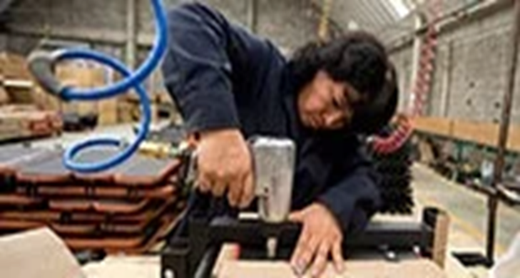
How UN Women work to develop women's economic power in developing countries
UN Women works with grassroots and civil society organizations to reach out to women who need it most. Particularly marginalized groups including rural women, domestic workers, migrant workers, and less skilled women. UN Women are working to increase the incomes of women who are often disadvantaged, improve access to and control of resources, and improve safety, such as protection from violence. (UN Women regular-resources-report-2023）

Slide 16
３.Eradicate violence against women
UN survey indicates an average 1 in 3 women is a victim of domestic violence.
2022 study undertaken UN Women and the United Nations office on Drugs and Crime: 45,000 women and girls worldwide have been killed by their families. On average, every hour, more than five women and girls were killed by family members and relatives. UN Women works with Member States and citizens to help women and girls affected by violence.

Slide 17
Report by the United Nations in 2023
the proportion of women who died in conflict doubled,
the fear that 612 million women and girls receive from war is 50% more than it was 10 years ago.
There has also been a 50% increase in the number of confirmed conflict-related sexual violence cases.
35% increase in the number of girls who have been subjected to serious human rights violations.

Slide 18
UN Women’s activities for Elimination of Violence against women and girls
In order to eliminate violence against women, women's organizations in various countries, with the support of UN Women, are training women to overcome violence they have received, building women's centers to provide counseling and vocational training for the victims of violence to help their rehabilitation, and training female police officers.

Slide 19
The United Nations Trust Fund for the Elimination of Violence Against Women
was established in 1996 after the Beijing Conference at the suggestion of the government of Japan and other several countries.
Japan Committee for UN Women has constantly contributed to this fund.

Slide 20
UN Security Council's Resolution on Women, Peace and Security WPS(2000) Speech by the Executive Director of UN Women on WPS Memorial Day on 31 October, 2024.
Today, 612 million women and girls are 50% more afraid of war than they were 10 years ago.
As stated in the UN Secretary-General's report, the proportion of women dying in conflict doubled in 2023. The number of confirmed conflict-related sexual violences increased by 50%, and the number of girls affected by serious human rights violations increased by 35%.

Slide 21
Speech by the Executive Director of UN Women on WPS Memorial Day on 31 October, 2024)
One in two women and girls affected by conflict face moderate to severe food insecurity.
61% of maternal deaths are concentrated in 35 conflict-affected countries. These numbers will continue to grow as maternity hospitals are bombed, reproductive health care is cut off, and sexual violence is on the rise.

Slide 22
Female solders in Ukraine
According to the Ministry of Defense of Ukraine, more than 42 thousand people (more than 15%) are in the army, of which 5000 are women on the front line
Notes:
ウクライナやイスラエルでは、女性兵士が頑張っている。

Slide 23
Kyiv, 12 March 2025 - Women-led and women’s rights organizations (WROs) in Ukraine have been severely impacted by funding suspensions by the U.S.A
a new survey by UN Women and organizations of the Government of revealed the following.
Nearly half of the 99 surveyed organizations had either received or were expecting US financial support when the suspension was announced in January 2025. Among these, 72 per cent reported severe disruptions, threatening the continuation of emergency response, humanitarian, and development initiatives across the country.
Five women’s rights organizations announced that they will have to close in the coming month, and overall, 35 organizations say that they are likely to have to stop working after six months, if no new funding is found to replace lost resources
arly half of the 99 surveyed organizations had either received or were expecting U.S. financial support when the suspension was announced in January 2025. Among these, 72 per cent reported severe disruptions, threatening the continuation of emergency response, humanitarian, and development initiatives across the country. Five women’s rights organizations announced that they will have to close in the coming month, and overall, 35 organizations say that they are likely to have to stop working after 6 months, if no new funding is found to replace lost resources.

Slide 24
Palestine (Gaza) and Israeli conflict
On October 7, 2023, Hamas unilaterally attacked Israel and took some civilians, including women, prisoners. Sexual violence against female prisoners of war.
However, Israel's attack on Gaza began in the early 2000s.

Slide 25
Gaza on April 26, 2024, photographed by Palestinian photographer Khan Younis（Time Oct.2024）

Slide 26
UN and other international agencies’top officials Statement on the situation in Gaza,September 23, 2024（I） UN Women, UNESCO, WHO, UNFPA, ILO, UNICEF, UNHCR, OHCHR, UNDP,UN Habitat, WPF, FAO,Care Internaional, Save the Children World leaders gathered in New York for the 79th session of the United Nations General Assembly. With the threat of a broader regional escalation looming over military attacks, the following leaders issued a monthly statement calling for an end to the horrific human suffering and humanitarian catastrophe in Gaza: •
Notes:
イスラエルのガザ攻撃は、2005年頃から始まっていた。
「ぼくたちは見た ーガザ・サムニ家の子どもたちー」古居みずえ監督 2005―7年、ガザの一般人の住宅が壊され、農地も破壊されている状況

Slide 27
Statement by UN & other interntional organization’s Top officials on the situation 2024 On Sept. 23, 2024（II）
According to Gaza's Ministry of Health, more than 41,000 Palestinians in Gaza, most of them civilians, including women, children, the elderly, and sometimes entire family members, have been killed and more than 95,500 have been injured, many of them are women, children and the elderly. In Gaza, hospitals were bombed and medical institutions were drastically reduced.
Notes:
昨日日本協会では、ガザにおける女性や少女の状況についてガザの「ガザにおける女性や少女に対する暴力について」UNRWA（国連パレスチナ難民救済事業機関） ガザ事務所 戦略立案チームリーダー吉田美紀さんに「ガザにおける女性や少女に対する暴力について」ガザからお話しいただきました。

Slide 28
５． UN Women’s humanitarian response operations
Drawing on its experience and expertise in gender equality and women's empowerment, UN Women has carried out humanitarian response operations in more than 40 crisis-affected countries, secured gender commitments in humanitarian coordination mechanisms, and provided psychosocial support, livelihood support, second-chance education, skills development, and vocational training to women and girls affected by the crisis.

Slide 29
6．Governance and National Planning
. National plans, policies, institutions, and budgets are where governments begin to translate their commitment to women into practical progress towards gender equality. However, it is easy to overlook measures to ensure that public services address women's needs and priorities.
Analyzing national plans, policies, institutions and budgets through the lens of gender equality means putting aside the conventional assumption that they are gender-neutral. This includes comprehensively assessing the gender gap and identifying actions to close it. Changes to promote gender equality should be supported by appropriate funding and systematically monitored progress in reducing gender discrimination.

Slide 30
7.Youth and Gender Equality 2030 Agenda for Sustainable Development"
With the new 2030 Agenda for Sustainable Development, we need to provide equal benefits to young people. The power and inspiration of young leaders is an important driver of accelerating progress in sustainable development and gender equality.

Slide 31
8. Women and girls and people with physical disabilities
It is estimated that one in five women lives with a disability. Organizations working on the rights of women and people with disabilities are committed to ensuring that women are fully involved in society, based on equality with others. UN Women supports organizations that work for women and girls with disabilities.

Slide 32
Palestinian girls participate in the wheelchair basketball championship in Gaza in December 2015
2015年12月にガザで行われた車いすバスケットボール選手権に参加するパレスチナの少女たち。写真:Samar Abu
写真:Samar Abu Al-ouf

Slide 33
Thank you for your attention to my speech.
This meeting is a great opportunity to unite for the promotion of the status of women and girls in Asia.

