Slide 1
Empowering Women and Girls through Education, Skills,
and Global Connection
Seinan Jo Gakuin University
Golden Z Club Hinako Yuda

Slide 2
01
Self Introduction
Today’s Topics
Why I became
a Golden Z Club Member
02
New project proposal
for women and girls
03

Slide 3
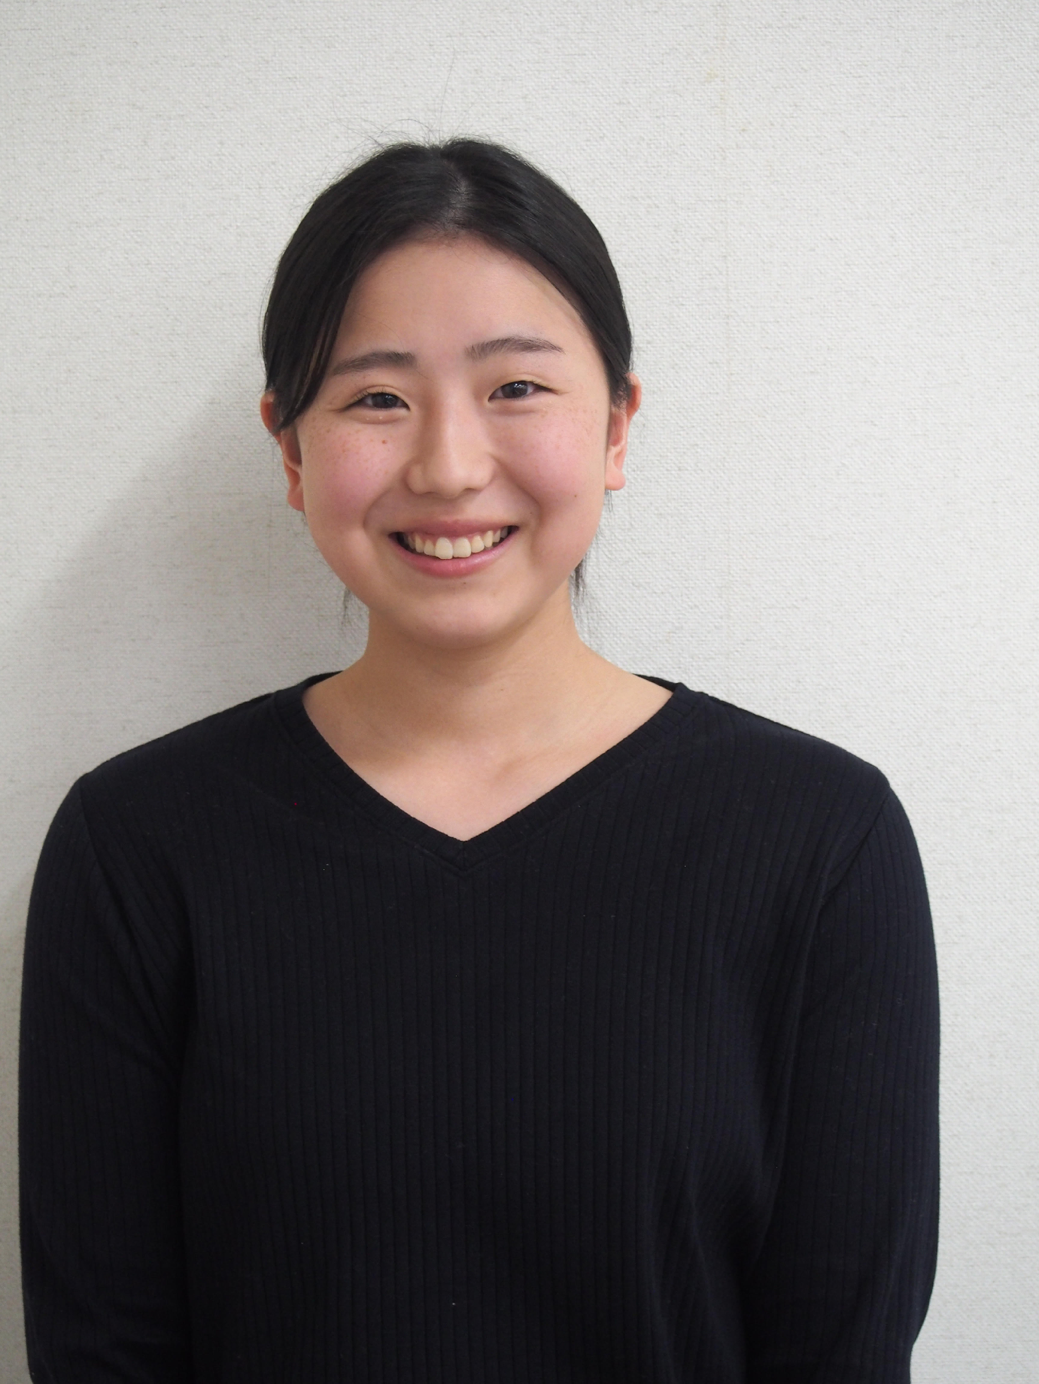
Self introduction
Name: Hinako Yuda
Hometown: Kitakyushu city, Japan
Age: 19-year-old university freshman
Major: English
Hobbies: Music, Dancing
Club Activities: Golden Z,
Ballroom Dancing, Aerobics
Future Goals: Playing a role in connecting Japan with the world

Slide 4
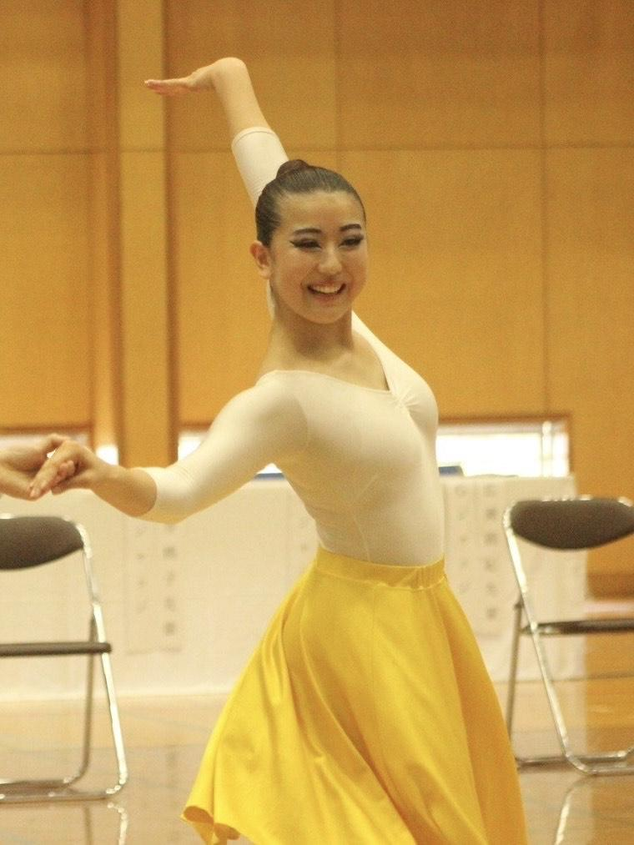
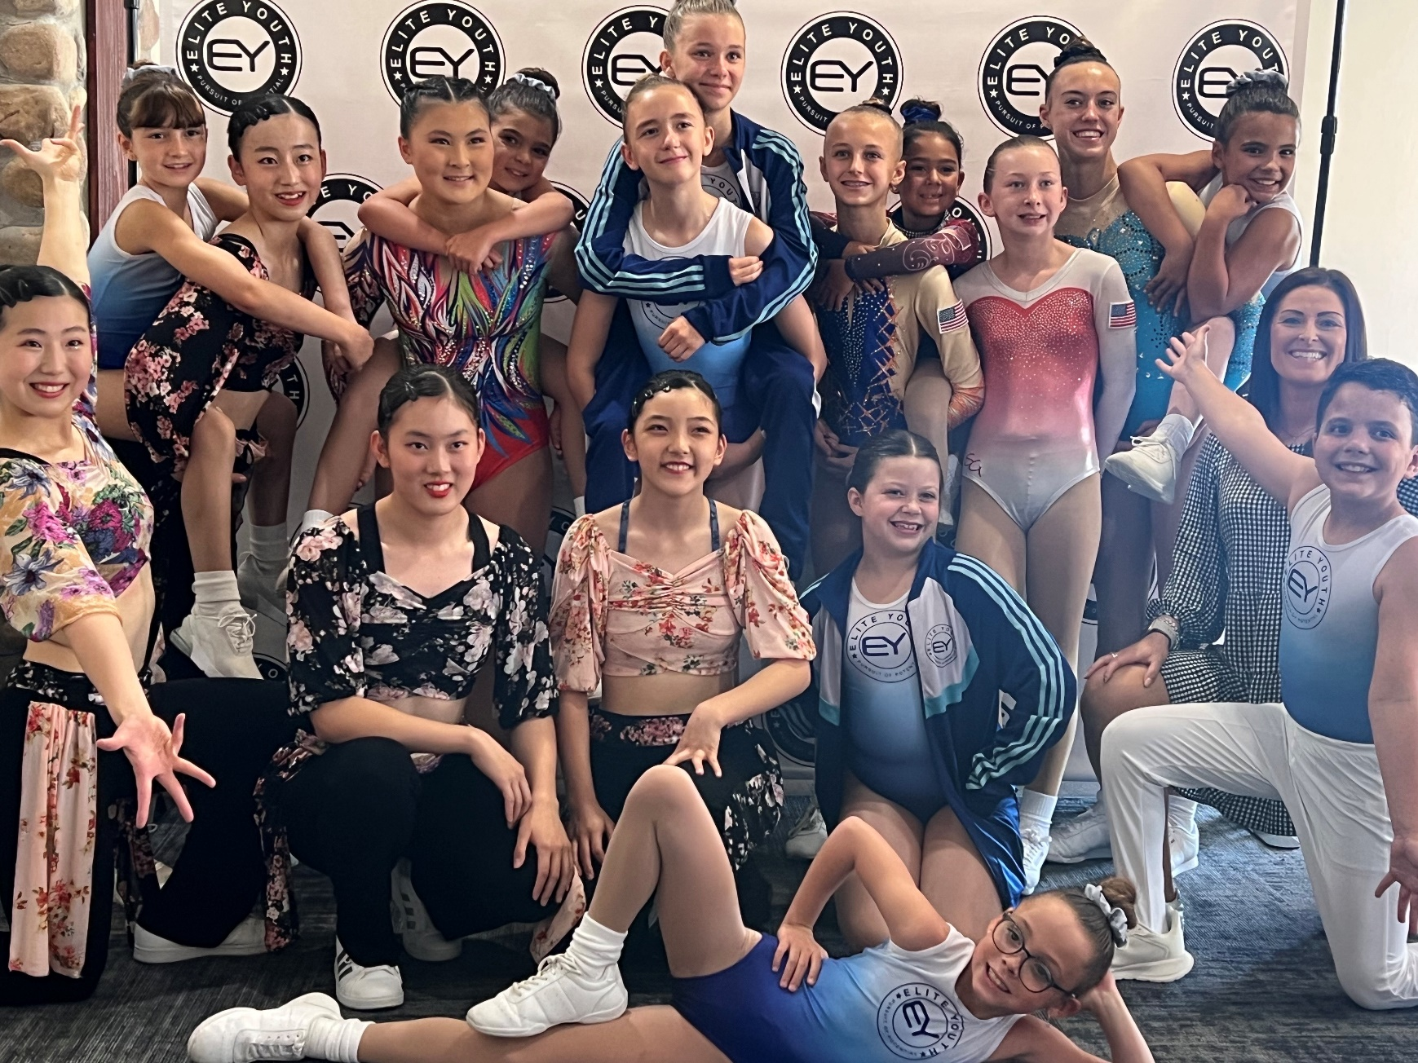
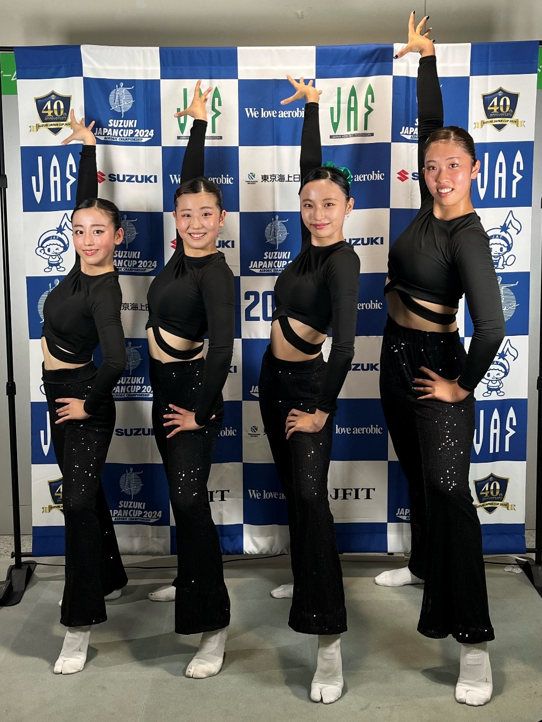
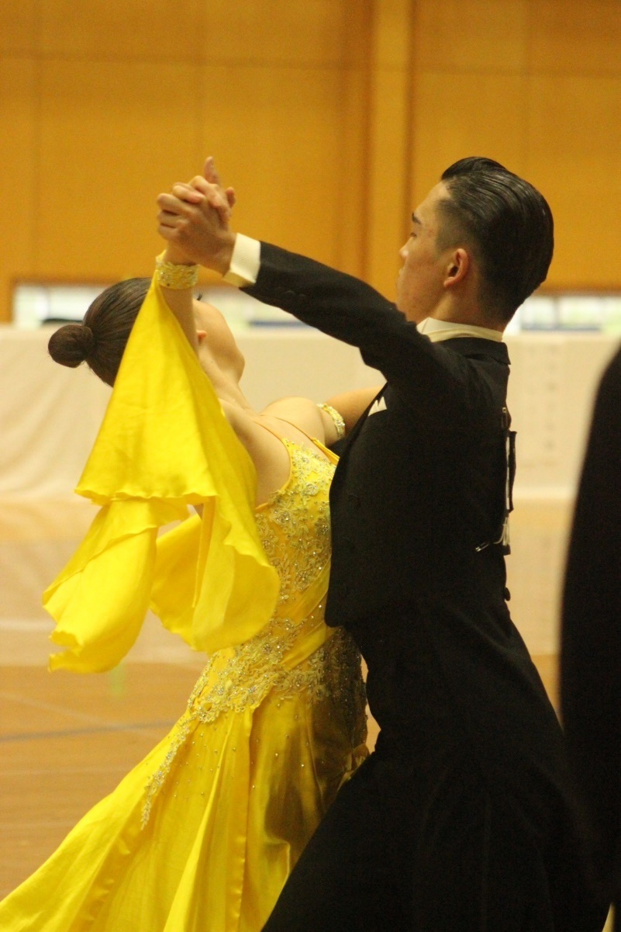

Slide 5
Self introduction
Name: Hinako Yuda
Hometown: Kitakyushu city, Japan
Age: 19-year-old university freshman
Major: English
Hobbies: Music, Dancing
Club Activities: Golden Z,
Ballroom Dancing, Aerobics
Future Goals: Playing a role in connecting Japan with the world

Slide 6
Why I became
a Golden Z Club Member
Know the world
International volunteer
Women’s University

Slide 7
New project proposal
for women and girls

Slide 8
① Provide opportunities for skill development
and vocational training
② Support for study abroad and training abroad
③ Provide opportunities to interact
with women and girls from other countries

Slide 9
① Provide opportunities for skill development and vocational training

Slide 10
Event
Study session
Sharing information

Slide 11
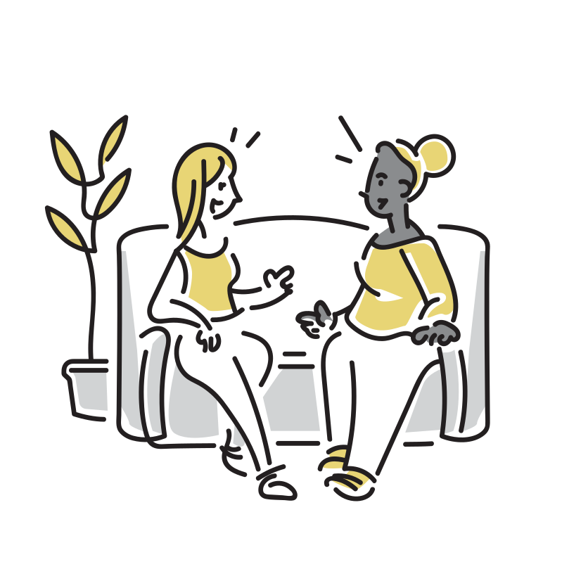
Improve motivation
Exchange Opportunity

Slide 12
② Support for study abroad and training abroad

Slide 13
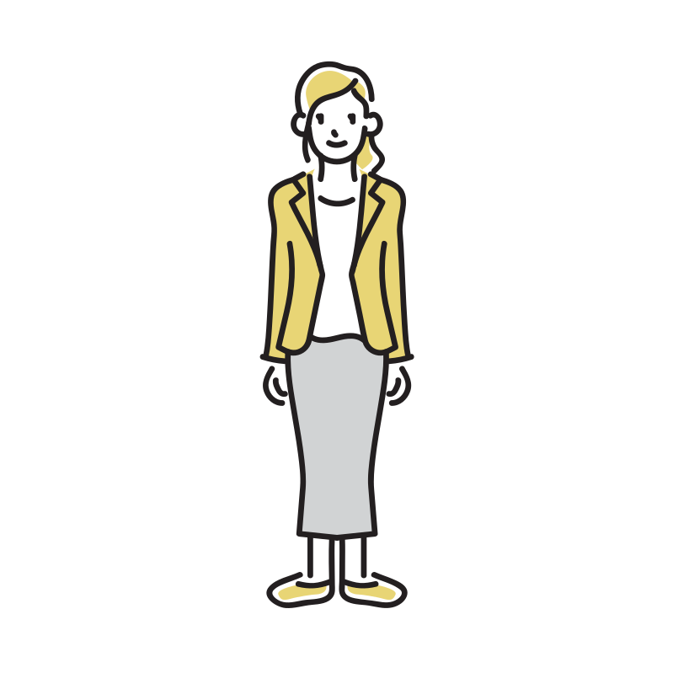
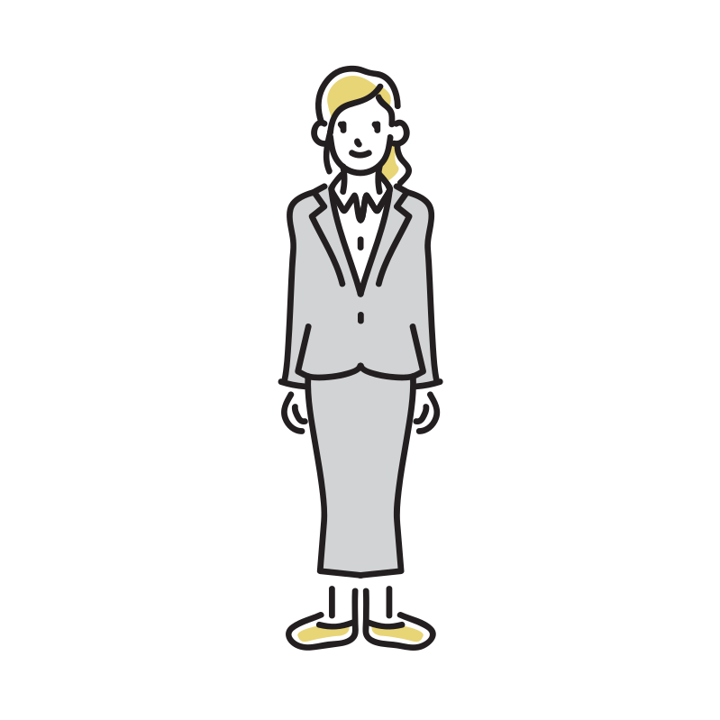
Provide information
Support by meeting

Slide 14
Travel expenses waived
Chance to go abroad

Slide 15
③ Provide opportunities to interact with women and girls
from other countries

Slide 16
☆ Opportunities for online and SNS exchanges
Sharing trivial details of our daily lives
Setting aside time to teach
each other our native languages

Slide 17
Promote mutual understanding and
improve our various skills

Slide 18
