Slide 1

District 32 (South Korea) Presentation
Cherry Sung | Chadwick International Z-Club
Notes:
10 min

Slide 2
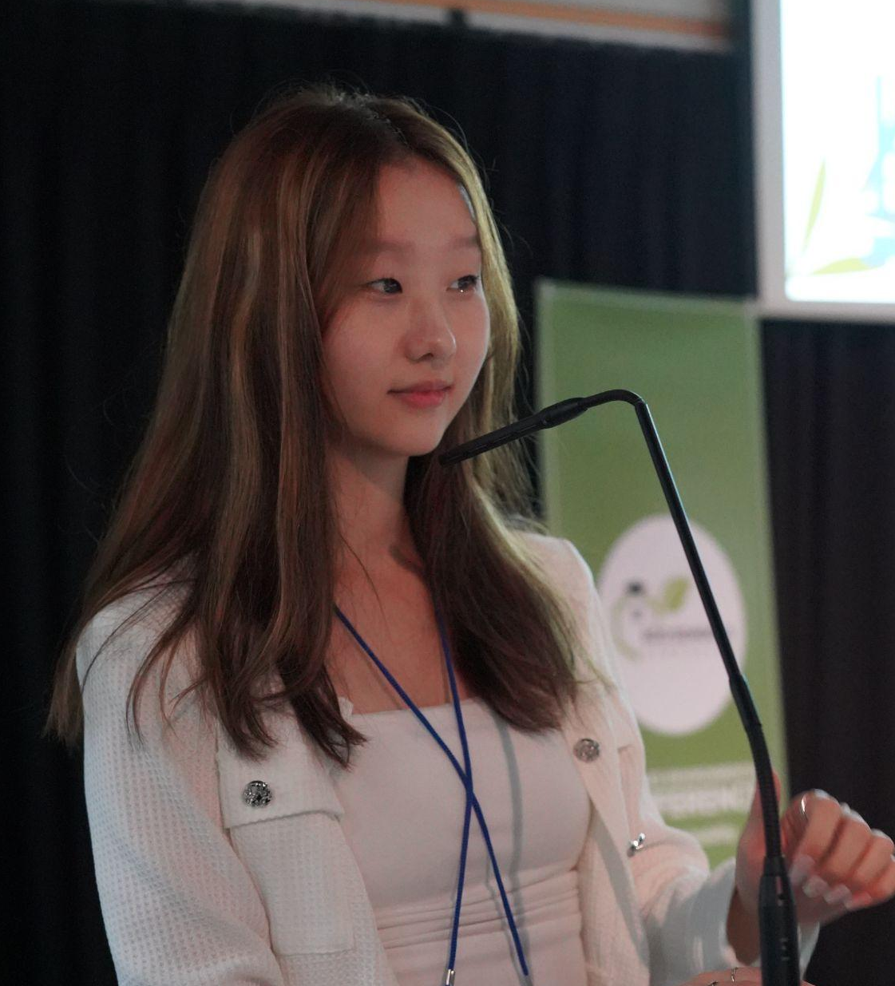

About Cherry Sung
18 years old, South Korean
Stanford University Class of 2029
2020 GSL Global Goals Competition Winner
2020 Minister of Environment Award
2020 Minister of Trade, Energy, and Industry Award
2021 Action for Nature International Eco Hero
2021 Youth Leads Award
2023 Crimson 18u18
2023 RISE Global Winner
2024 Zonta Young Woman in Public Affairs

Slide 3
Table of contents
01
02
03
Self introduction
Becoming a Zontian
About my activism journey - gender equality and environmentalism
From Nepal service trip to YWPA and Golden Z
Project Idea
Women and girls empowerment

Slide 4
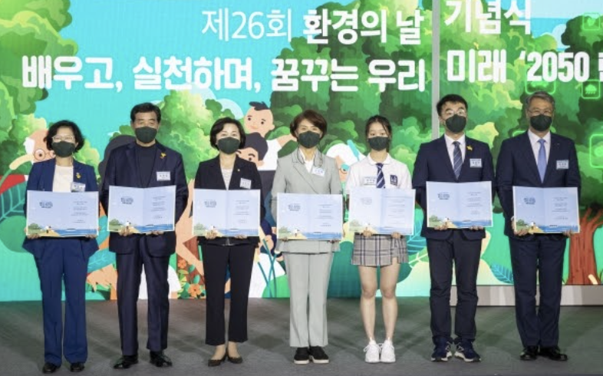
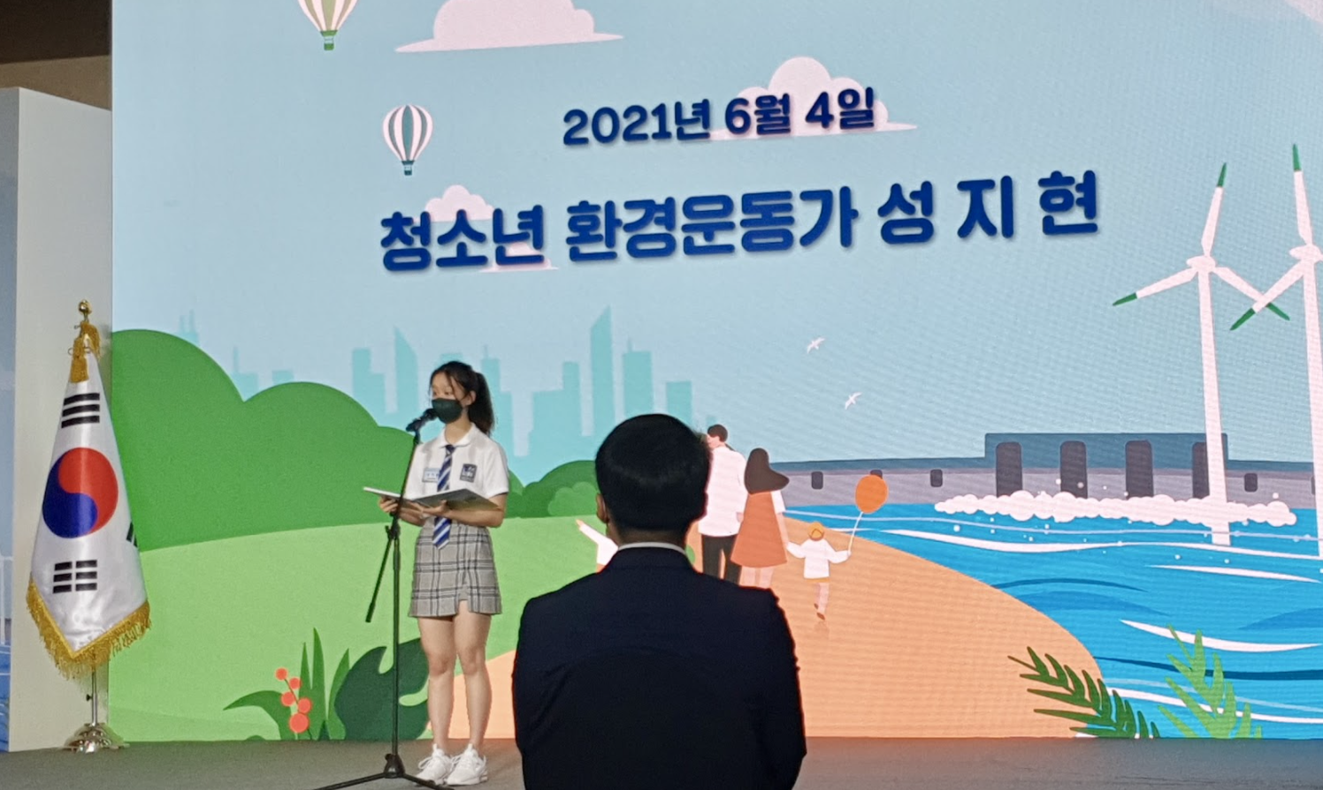
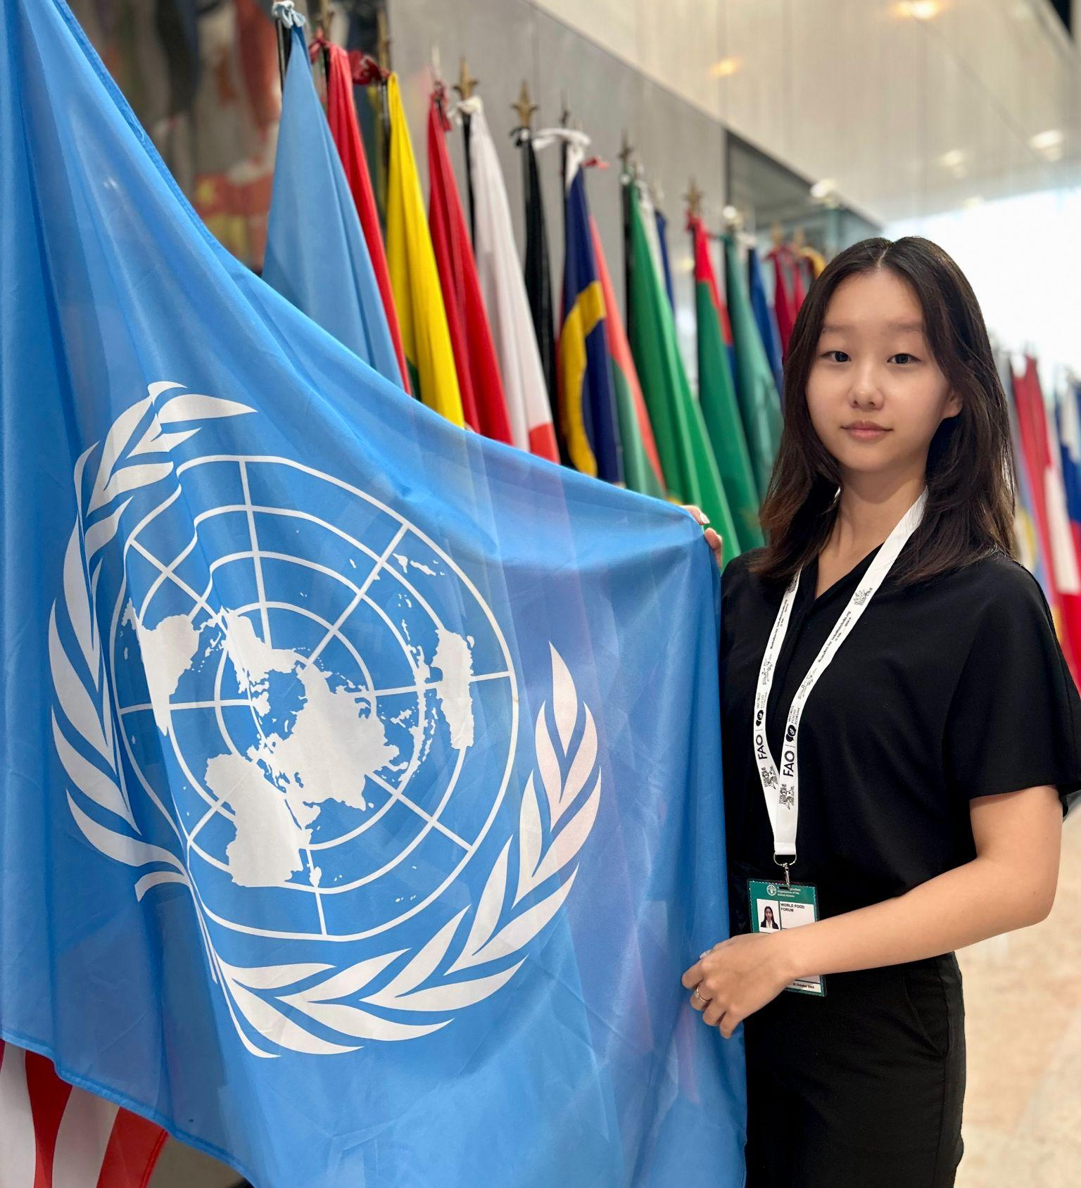
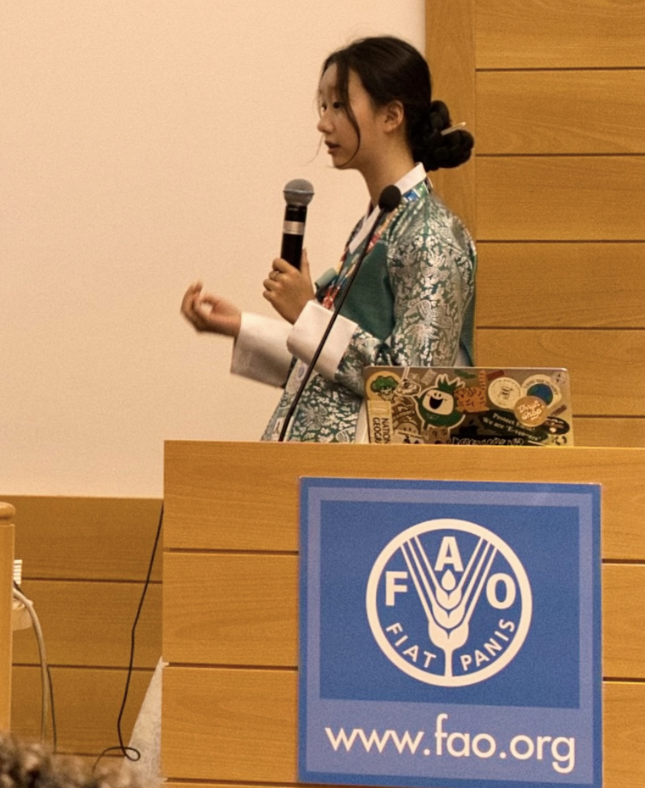
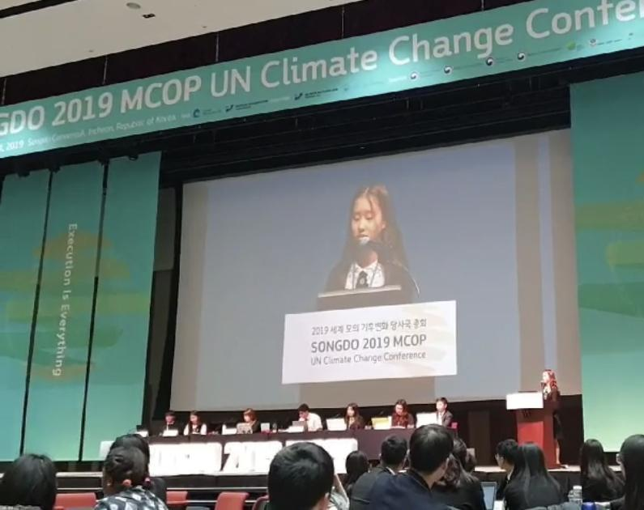
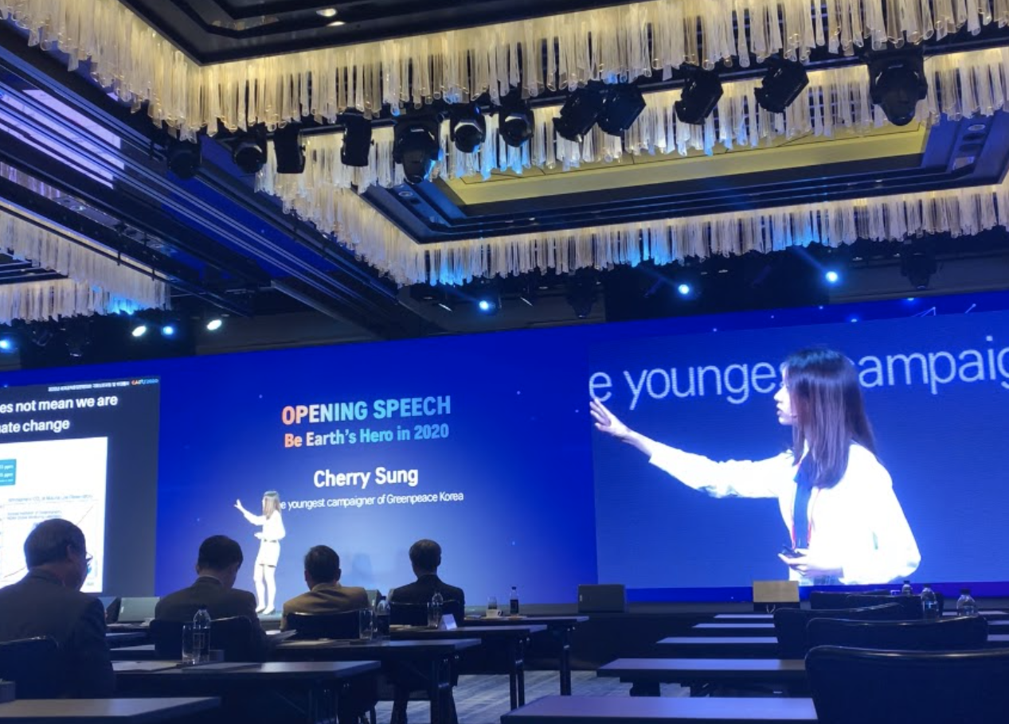

Slide 5
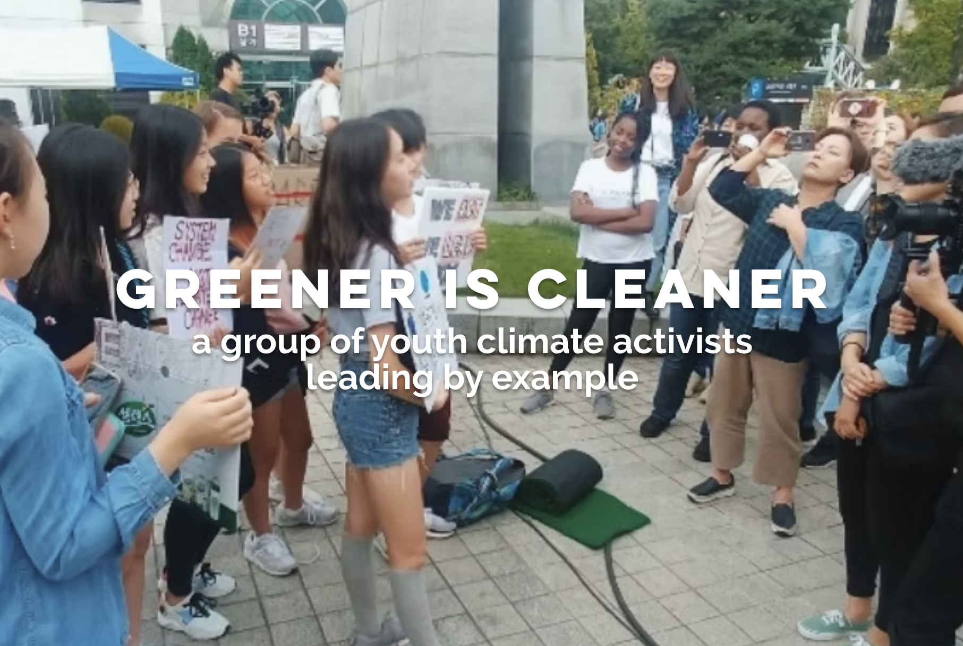


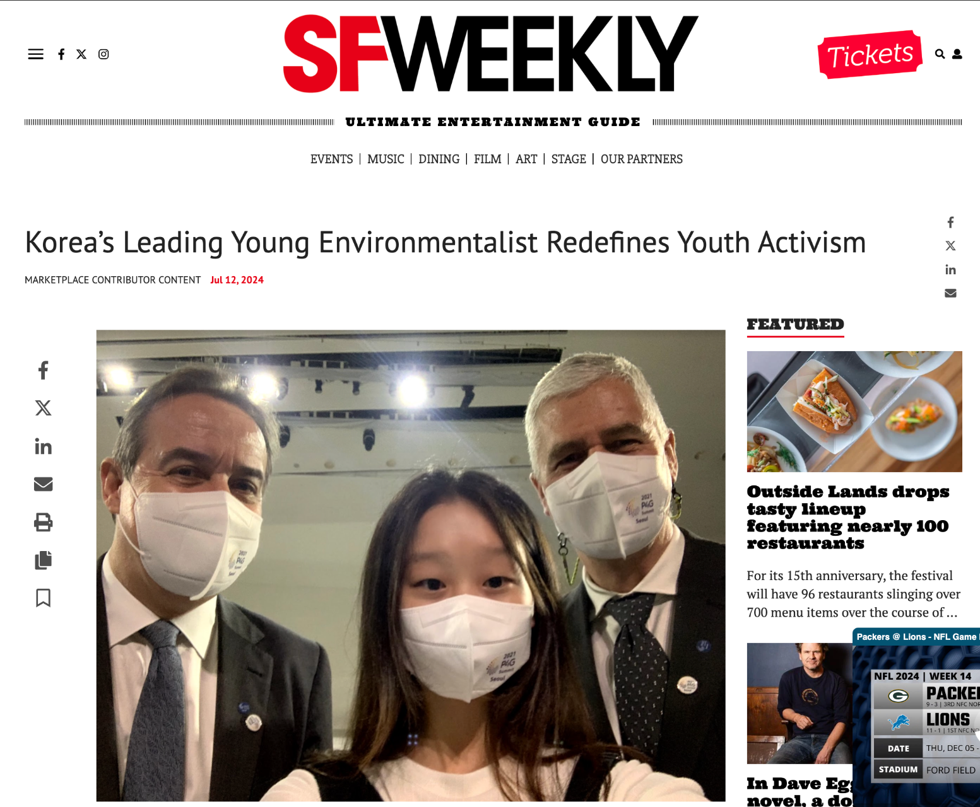
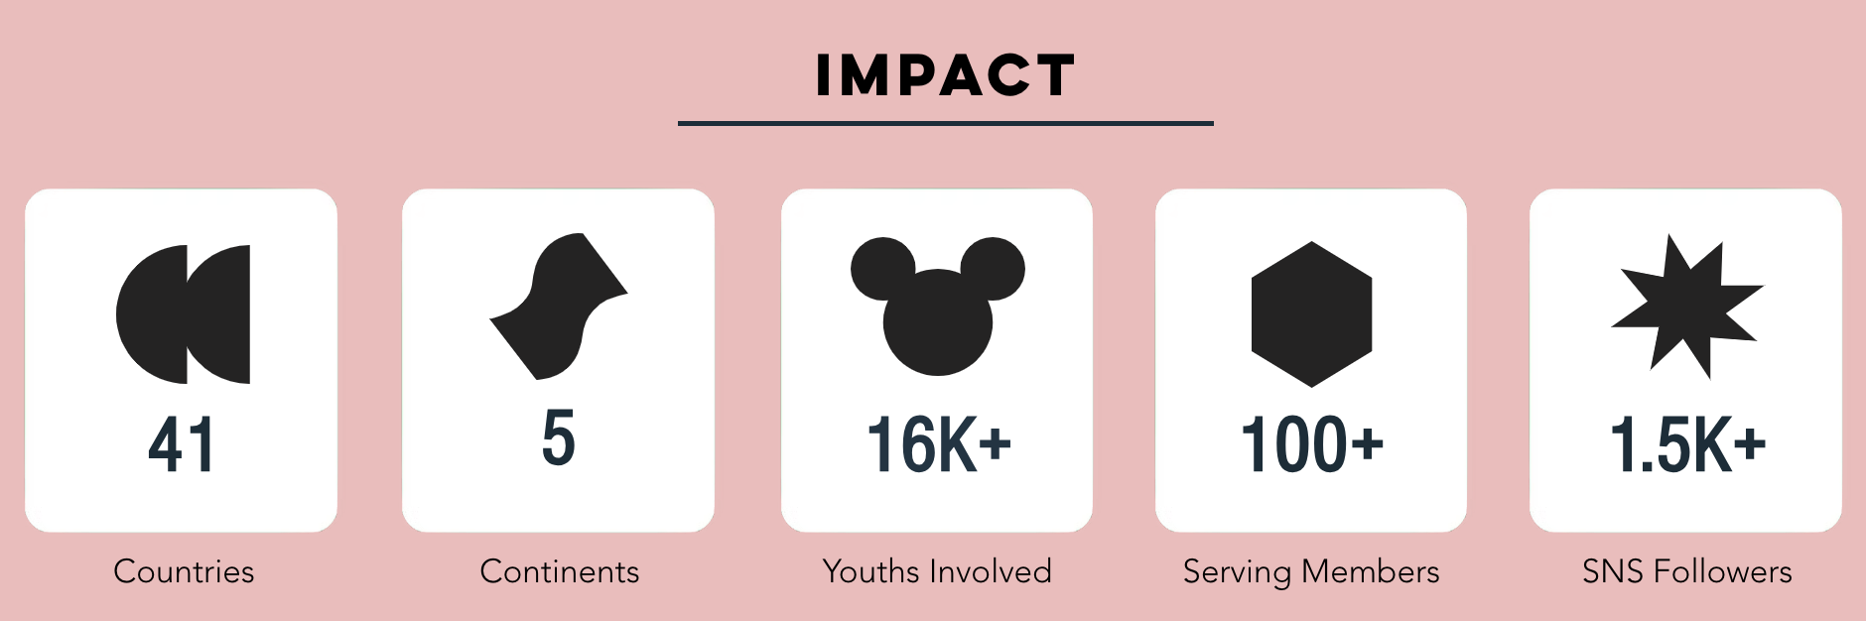

Slide 6
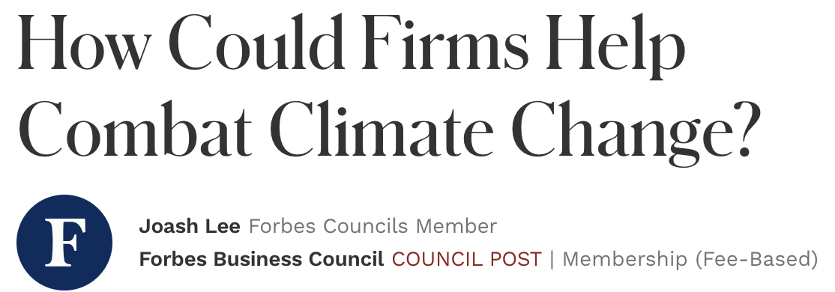
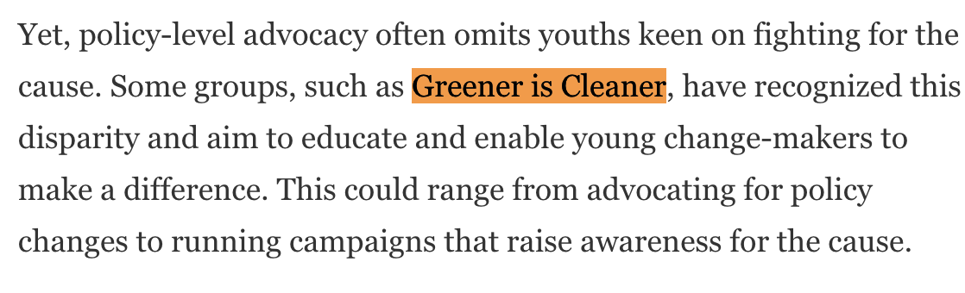
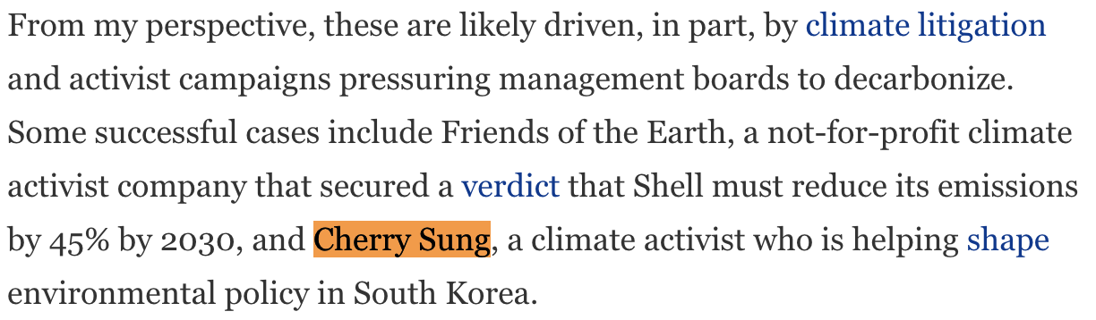

Slide 7
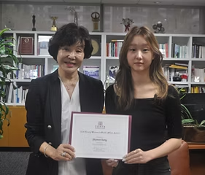
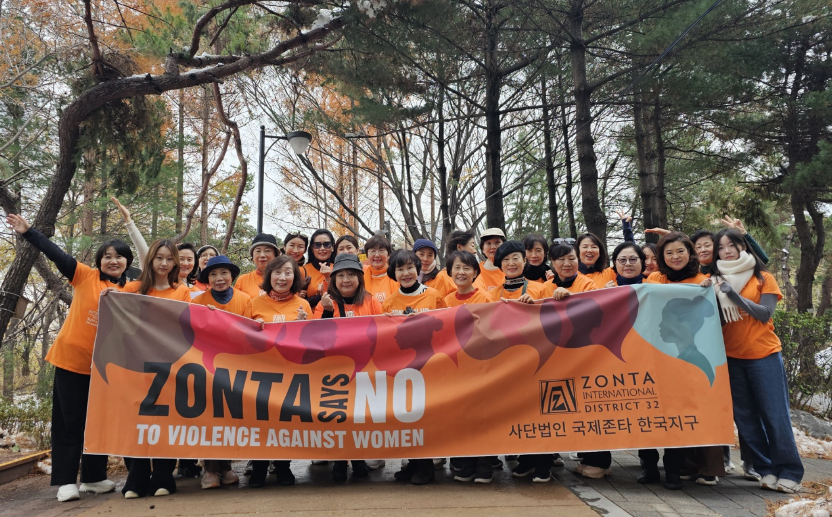
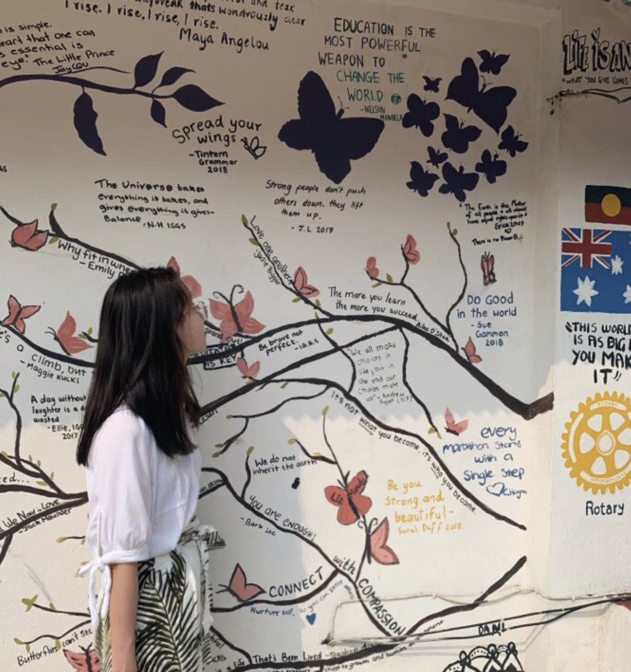
Becoming a Zontian
Lead by example | Continue the community | Golden Z
YWPA
Seven Women Nepal
District 32 (S. Korea)

Slide 8
Zonta innovation competition

Slide 9
Objective: Inspire and empower youth to develop innovative, practical solutions that advance gender equality in their communities and beyond.
Zonta will host a global competition inviting girls and young women (ages 15–25) to propose and develop innovative solutions addressing gender equality challenges. Participants will pitch their ideas to a panel of experts, with top projects receiving funding, mentorship, and resources for implementation.

Slide 10
In every sphere, women’s rights and contributions are vital for a future where technology serves humanity, not the other way around.
United Nations

Slide 11
Key competition themes
Economic Empowerment: Solutions to close the gender pay gap, promote financial literacy, or support women entrepreneurs.
Education Access: Innovations to improve access to quality education for girls and women, especially in marginalized communities.
Workplace Equality: Ideas to address workplace discrimination, harassment, or promote inclusive leadership.
Health & Wellbeing: Projects tackling issues like menstrual equity, reproductive rights, and mental health support for women.
Technology for Equality: Use of technology to combat gender-based violence, improve access to resources, or amplify women’s voices.

Slide 12



Generic; no central “theme” & awards not aligned with a specific issue → focus on gender equality solutions

Slide 13
Long-term Goals
Zontian Engagement: Involve more Z clubs and Golden Z clubs to Zonta activities.
Sustainable Impact: Track and support successful projects to ensure implementation and scalability.
Youth Engagement: Build a network of young innovators who can continue collaborating with Zonta on gender equality initiatives.
Awareness and Advocacy: Use competition outcomes to amplify youth-driven ideas and influence global discussions on gender equality.
Expand STEM: Allow this competition as an opportunity to expand STEM education and application in countries with low women in STEM rates.

Slide 14
Thank
you!
Do you have any questions?
cherrysung06@gmail.com

